Slide 1
Communicating with Data – Intro to Tableau
Dr. Ab Mosca (they/them)
Slides based off slides courtesy of Jordan Crouser (https://jcrouser.github.io/)

Slide 2
Plan for Today
Introduction to Tableau
Getting started:
Connecting to a data file
Creating views
Using “Show Me”: a recommender system for views
Practice
Discussion (time permitting)
Lab pt. 1 modeled on “Getting Started with Tableau Desktop” Version 8.2
Last Updated June 11, 2014 3:09 PM Copyright © 2014 Tableau Software

Slide 3

A drag-and-drop tool for mapping data dimensions onto visual dimensions
Today we will learn:
How to load data into Tableau
A little bit about how Tableau organizes data
How to tell Tableau which facets of the data to display, and how
Introduction to Tableau

Slide 4

Visualization and business analytics software with a strong focus on relational data
Idea originally developed at Stanford University
Now owned by Salesforce
What is
?

Slide 5
Visualization and business analytics software with a strong focus on relational data
Idea originally developed at Stanford University
Now owned by Salesforce
What is
?
What’s relational data?

Slide 6
airlines
#> # A tibble: 16 × 2
#> carrier name
#> <chr> <chr>
#> 1 9E Endeavor Air Inc.
#> 2 AA American Airlines Inc.
#> 3 AS Alaska Airlines Inc.
#> 4 B6 JetBlue Airways
#> 5 DL Delta Air Lines Inc.
#> 6 EV ExpressJet Airlines Inc.
#> # i 10 more rows
Relational Data
airports
#> # A tibble: 1,458 × 8
#> faa name lat lon alt tz dst tzone
#> <chr> <chr> <dbl> <dbl> <dbl> <dbl> <chr> <chr>
#> 1 04G Lansdowne Airport 41.1 -80.6 1044 -5 A America/Ne…
#> 2 06A Moton Field Municipal Airport 32.5 -85.7 264 -6 A America/Ch…
#> 3 06C Schaumburg Regional 42.0 -88.1 801 -6 A America/Ch…
#> 4 06N Randall Airport 41.4 -74.4 523 -5 A America/Ne…
#> 5 09J Jekyll Island Airport 31.1 -81.4 11 -5 A America/Ne…
#> 6 0A9 Elizabethton Municipal Airport 36.4 -82.2 1593 -5 A America/Ne…
#> # i 1,452 more rows
planes
#> # A tibble: 3,322 × 9
#> tailnum year type manufacturer model engines seats speed engine
#> <chr> <int> <chr> <chr> <chr> <int> <int> <int> <chr>
#> 1 N10156 2004 Fixed wing multi … EMBRAER EMB-… 2 55 NA Turbo…
#> 2 N102UW 1998 Fixed wing multi … AIRBUS INDU… A320… 2 182 NA Turbo…
#> 3 N103US 1999 Fixed wing multi … AIRBUS INDU… A320… 2 182 NA Turbo…
#> 4 N104UW 1999 Fixed wing multi … AIRBUS INDU… A320… 2 182 NA Turbo…
#> 5 N10575 2002 Fixed wing multi … EMBRAER EMB-… 2 55 NA Turbo…
#> 6 N105UW 1999 Fixed wing multi … AIRBUS INDU… A320… 2 182 NA Turbo…
#> # i 3,316 more rows
weather
#> # A tibble: 26,115 × 15
#> origin year month day hour temp dewp humid wind_dir wind_speed wind_gust
#> <chr> <int> <int> <int> <int> <dbl> <dbl> <dbl> <dbl> <dbl> <dbl>
#> 1 EWR 2013 1 1 1 39.0 26.1 59.4 270 10.4 NA
#> 2 EWR 2013 1 1 2 39.0 27.0 61.6 250 8.06 NA
#> 3 EWR 2013 1 1 3 39.0 28.0 64.4 240 11.5 NA
#> 4 EWR 2013 1 1 4 39.9 28.0 62.2 250 12.7 NA
#> 5 EWR 2013 1 1 5 39.0 28.0 64.4 260 12.7 NA
#> 6 EWR 2013 1 1 6 37.9 28.0 67.2 240 11.5 NA
#> # i 26,109 more rows
#> # i 4 more variables: precip <dbl>, pressure <dbl>, visib <dbl>,
#> # time_hour <dttm>
https://r4ds.had.co.nz/relational-data.html

Slide 7
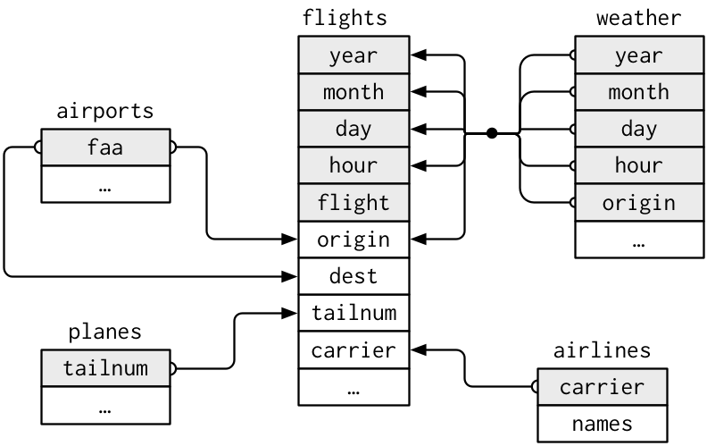
Relational Data
https://r4ds.had.co.nz/relational-data.html

Slide 8
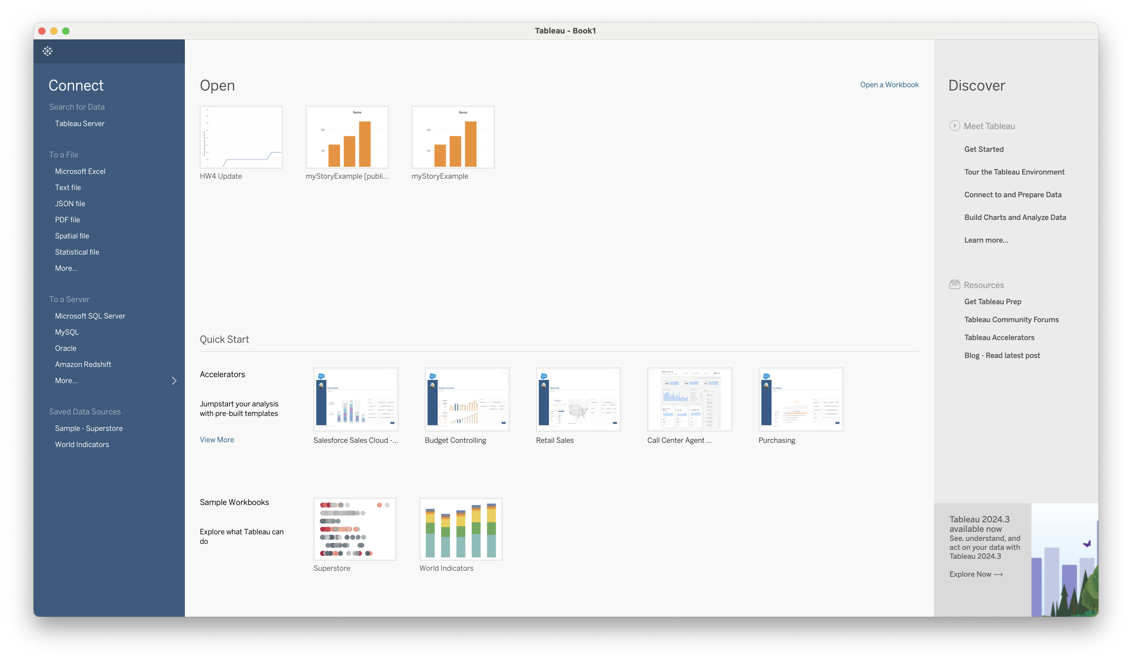
Opening Tableau
Tableau basics

Slide 9
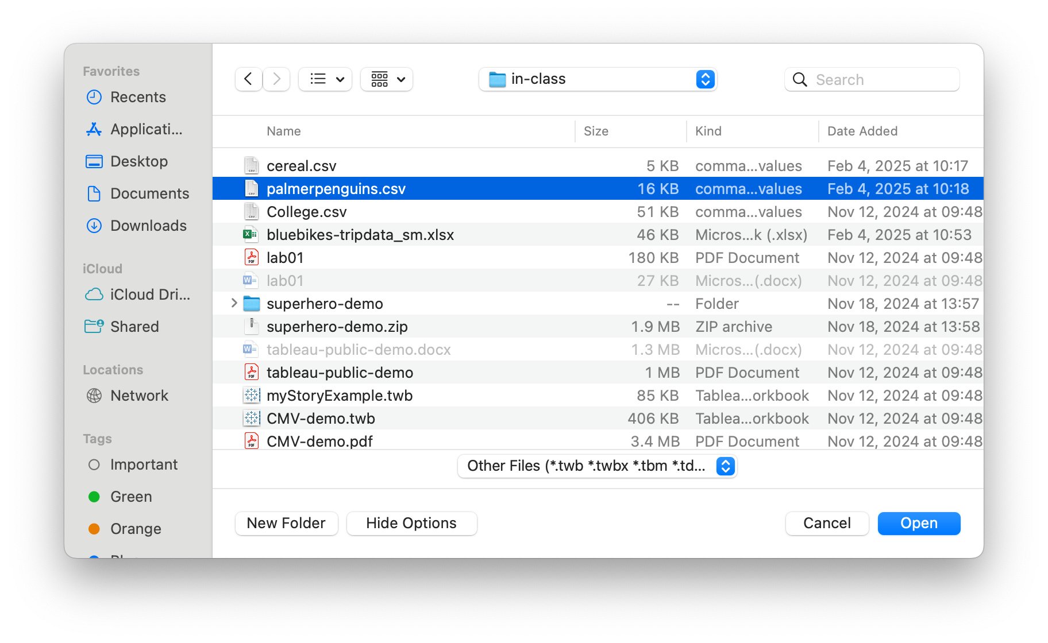
Choose data
Tableau basics

Slide 10
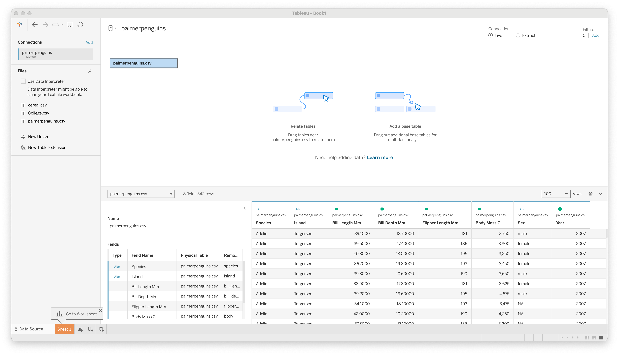
View data
Tableau basics

Slide 11
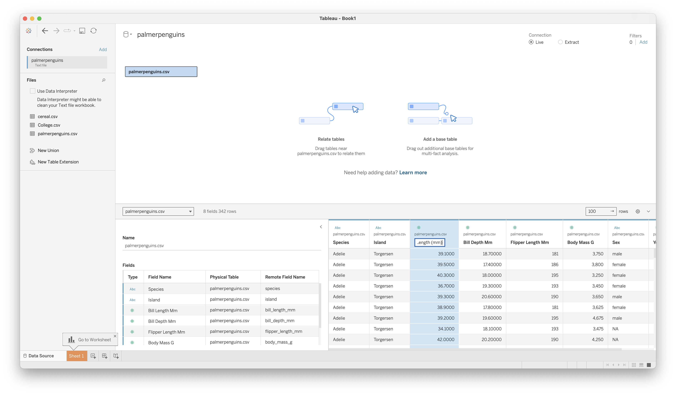
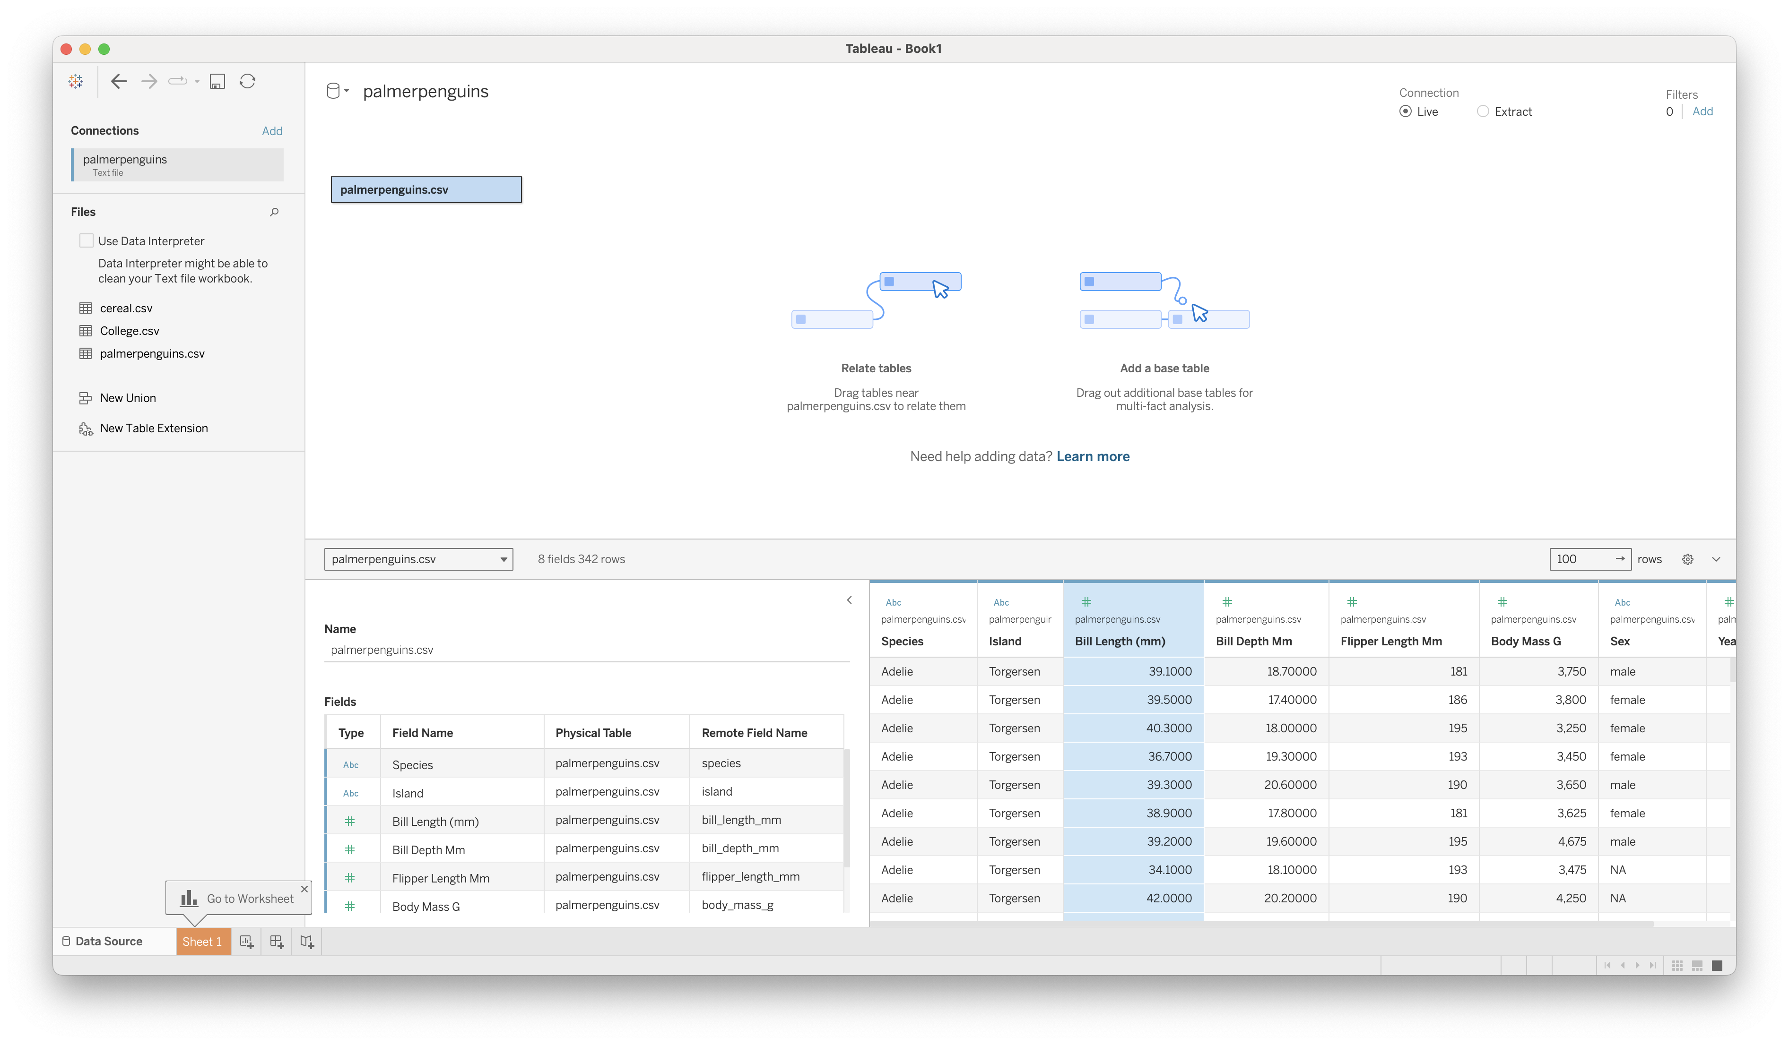
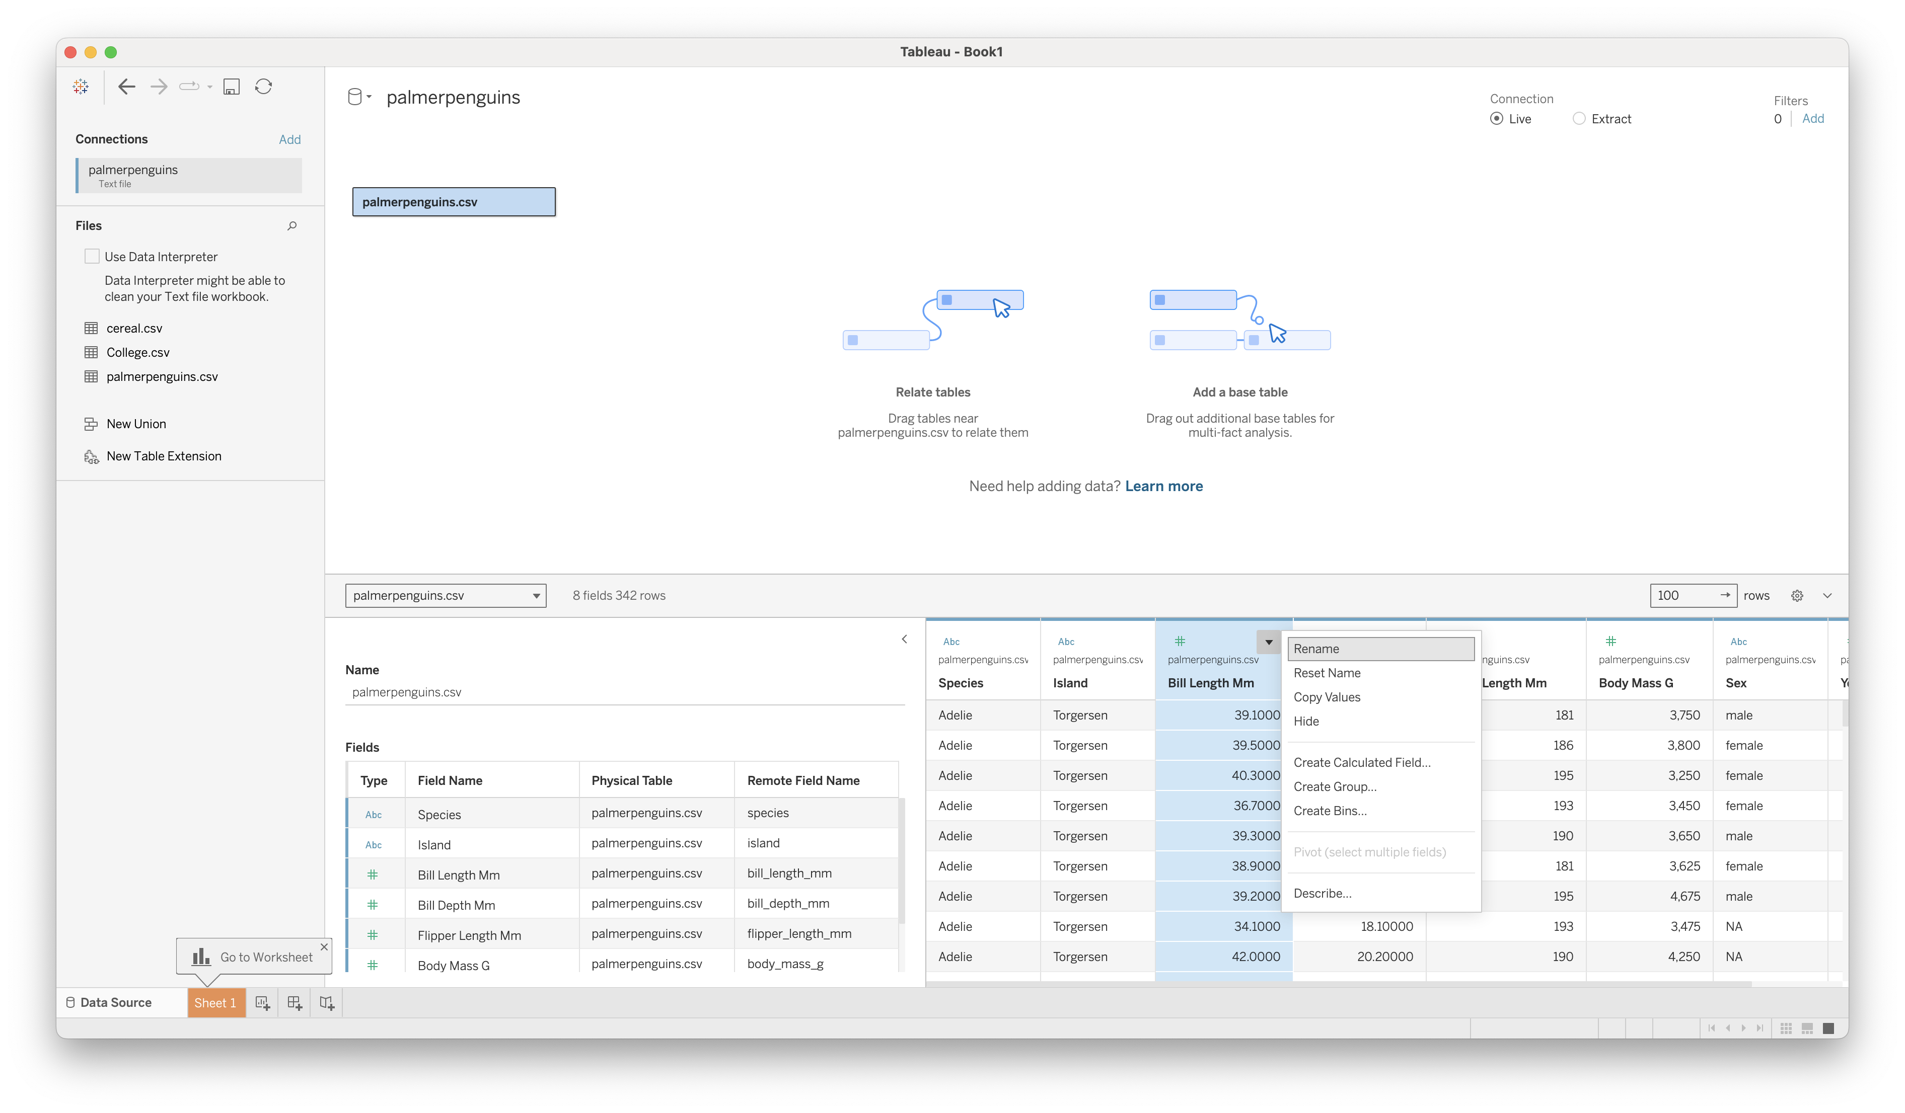
Rename Variables
Tableau basics

Slide 12
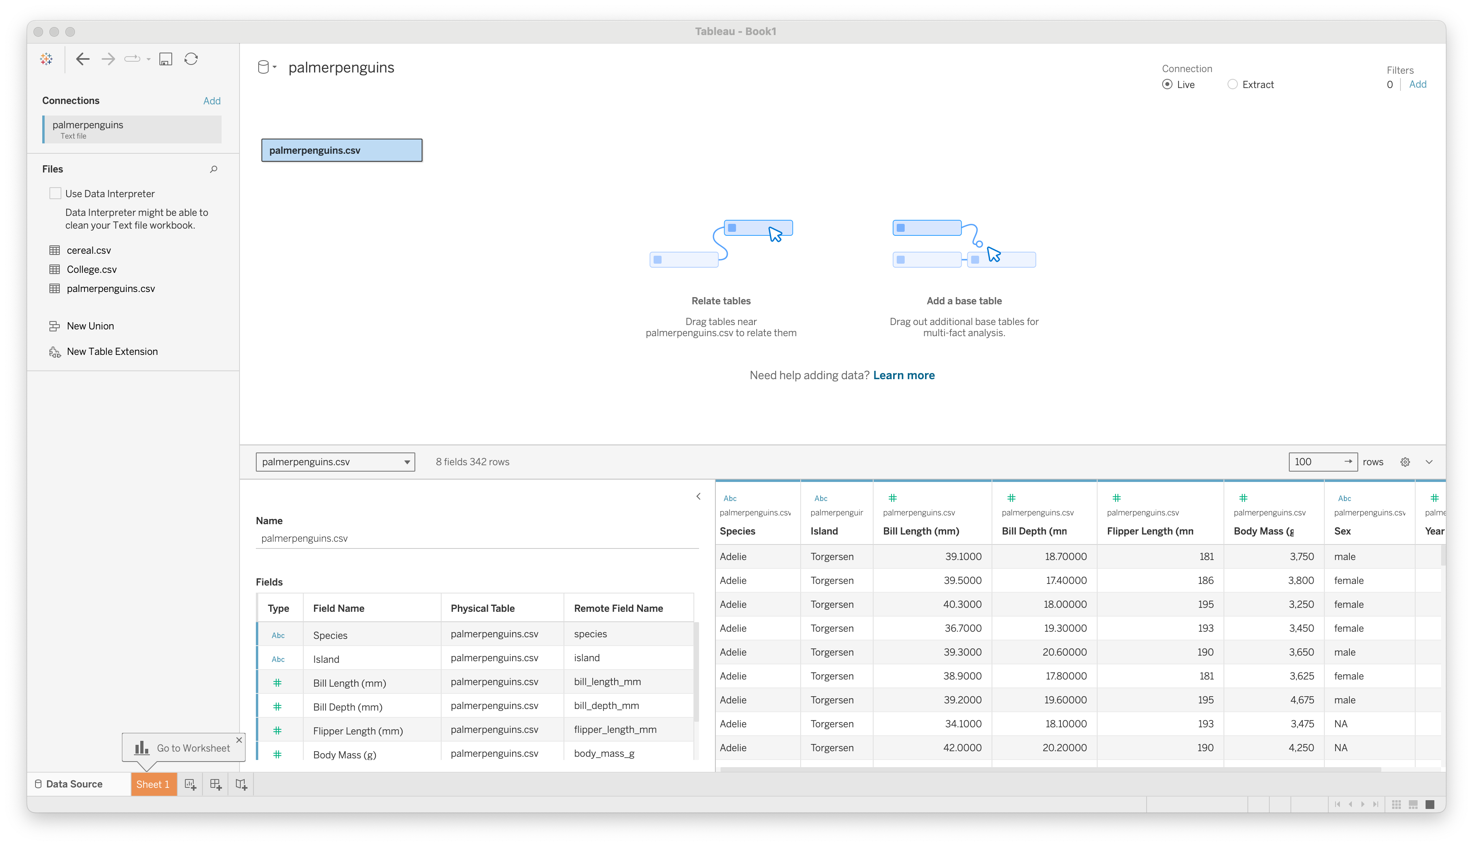
Worksheet
Tableau basics

Slide 13
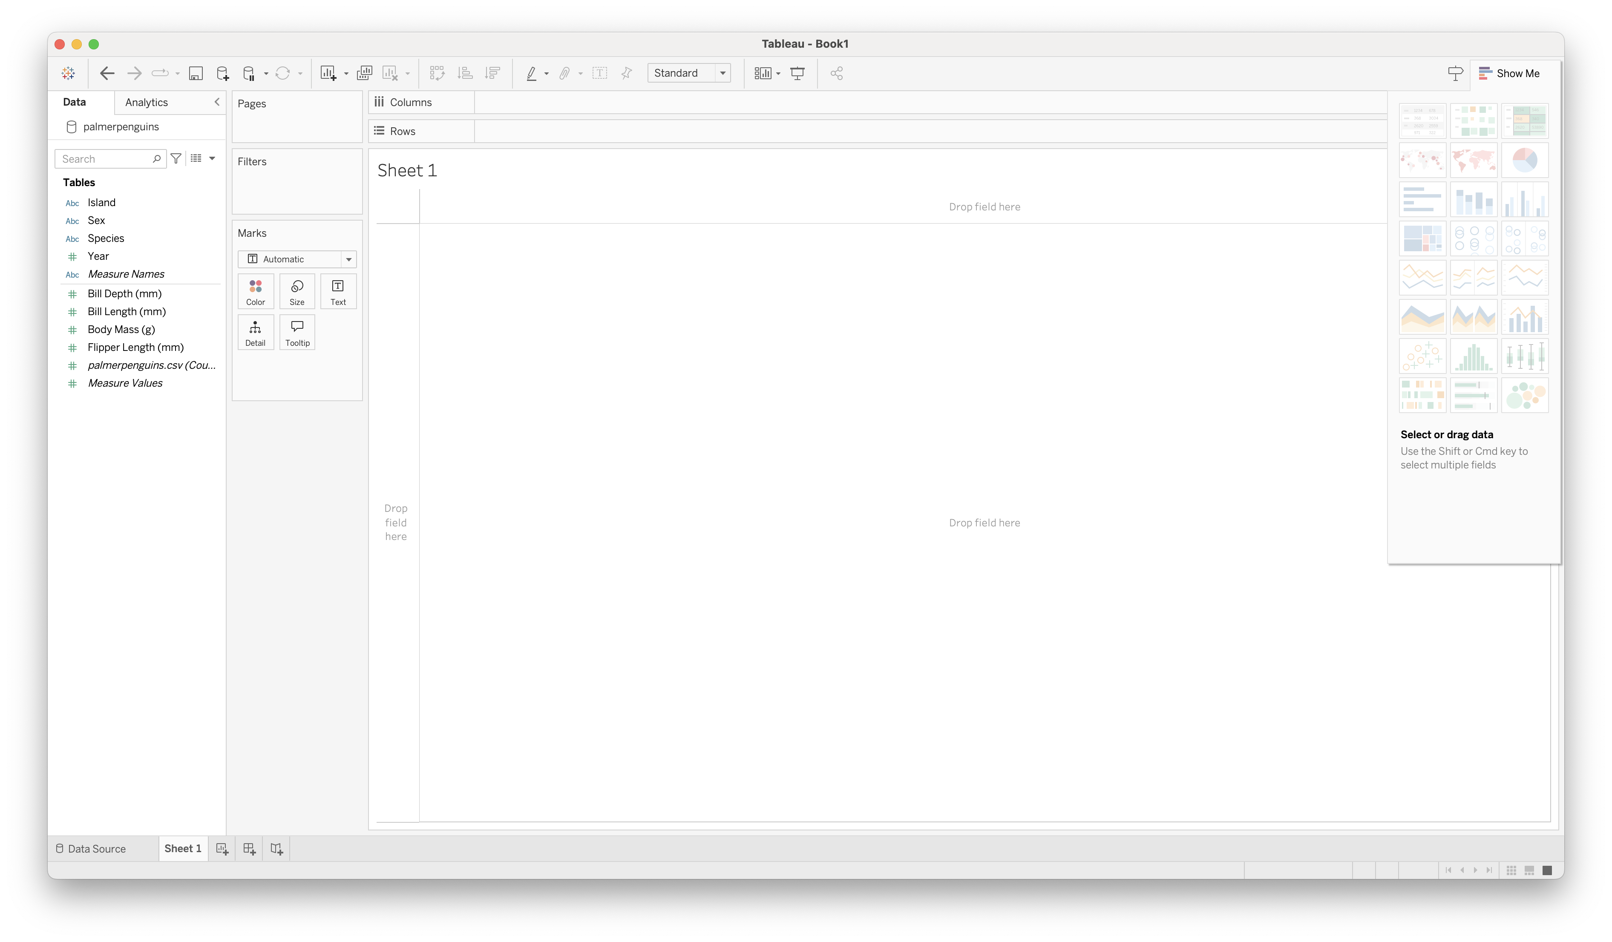
New Worksheet
Tableau basics

Slide 14
Data
Tableau basics

Slide 15
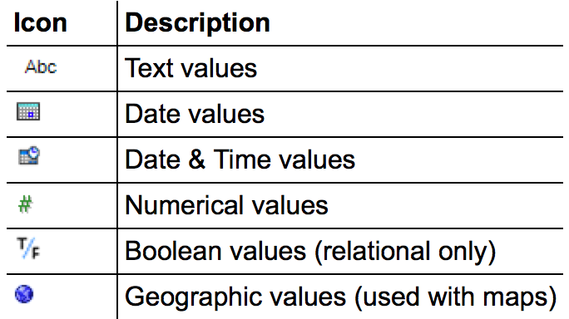
Data Types
Tableau basics
All data fields are assigned one of the following types:
Occasionally the auto-detected type is wrong; this can be manually overridden using the menu

Slide 16
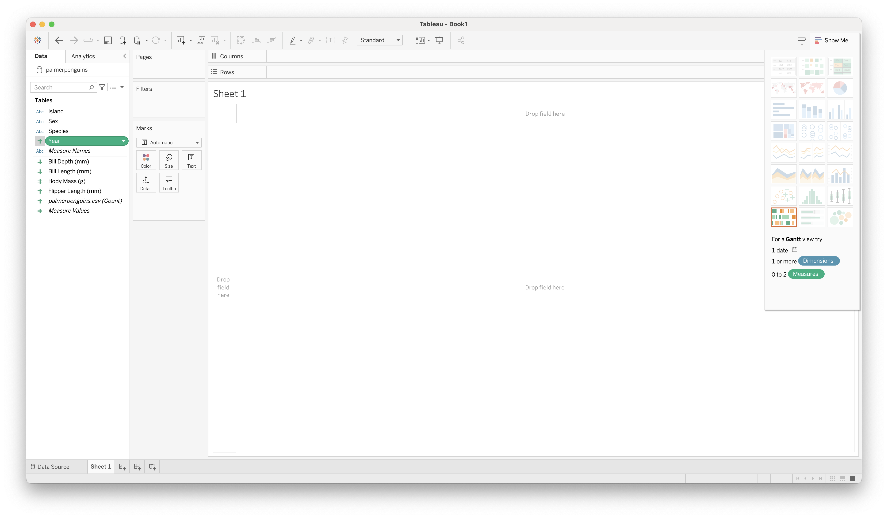
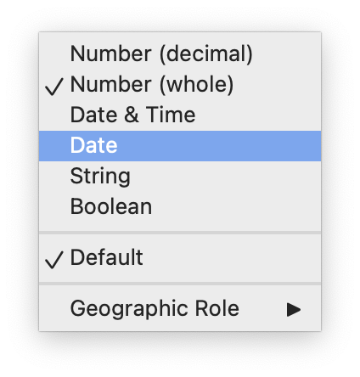
Changing Data Types
Tableau basics

Slide 17
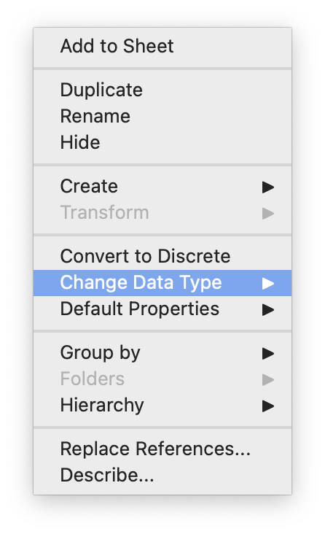
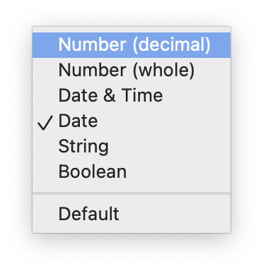
Changing Data Types
Tableau basics

Slide 18
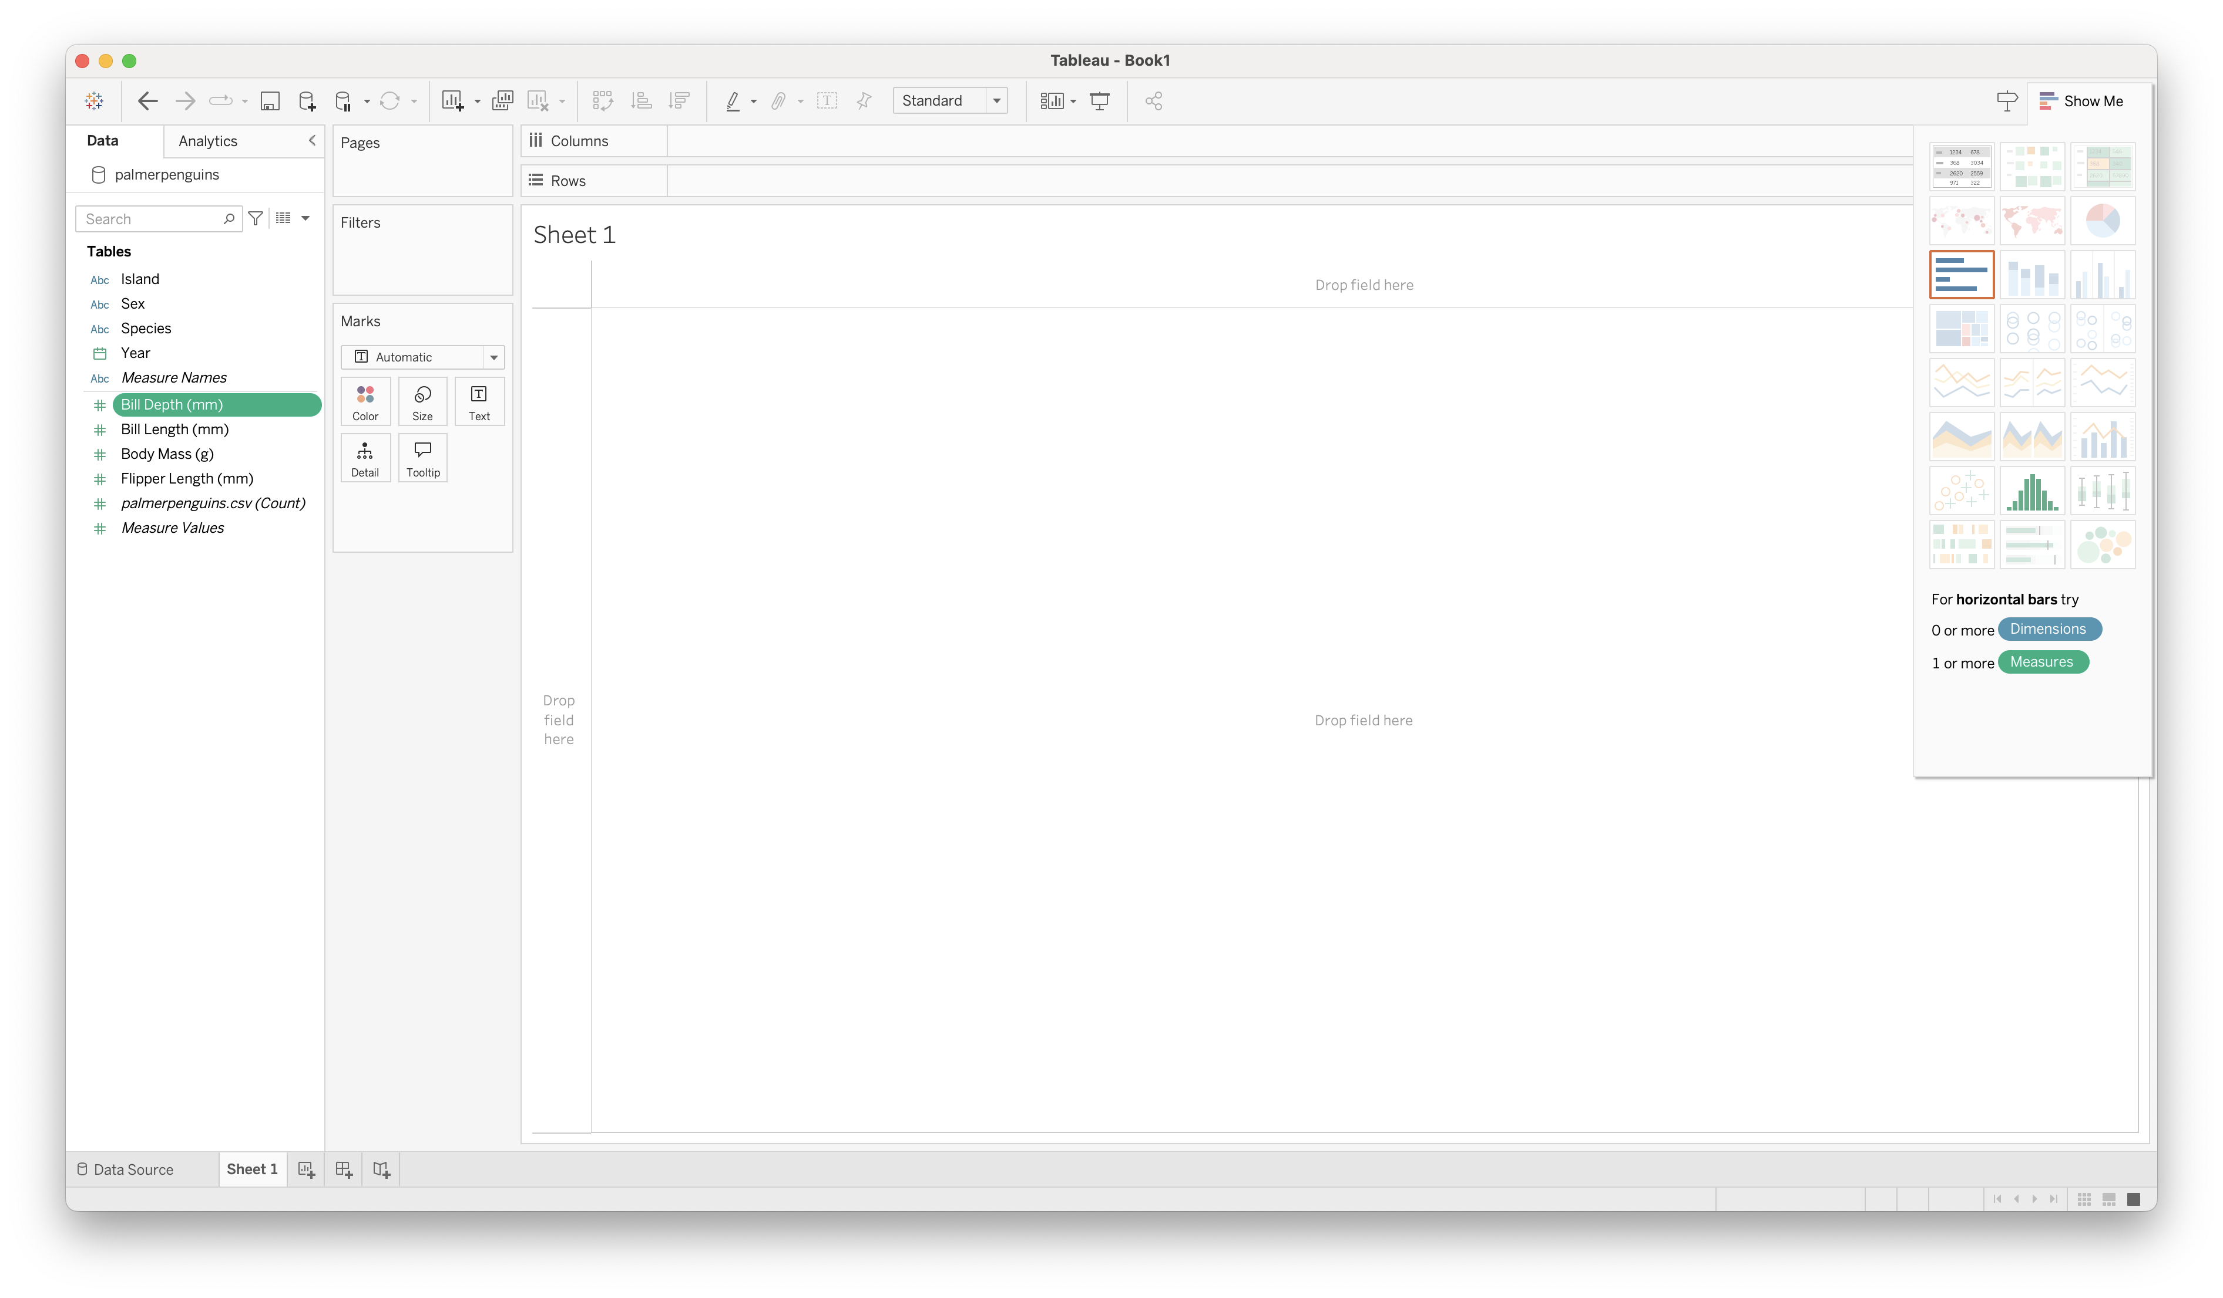
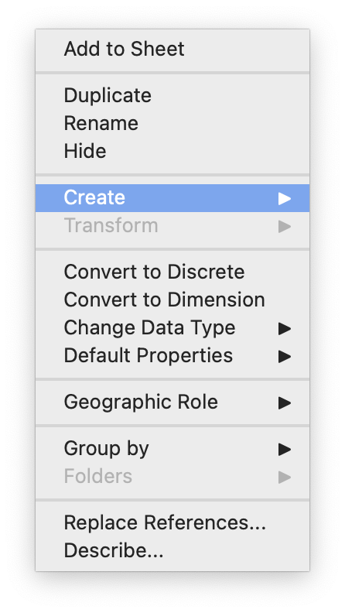
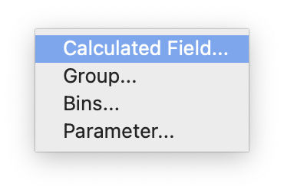
Adding Measures
Tableau basics

Slide 19
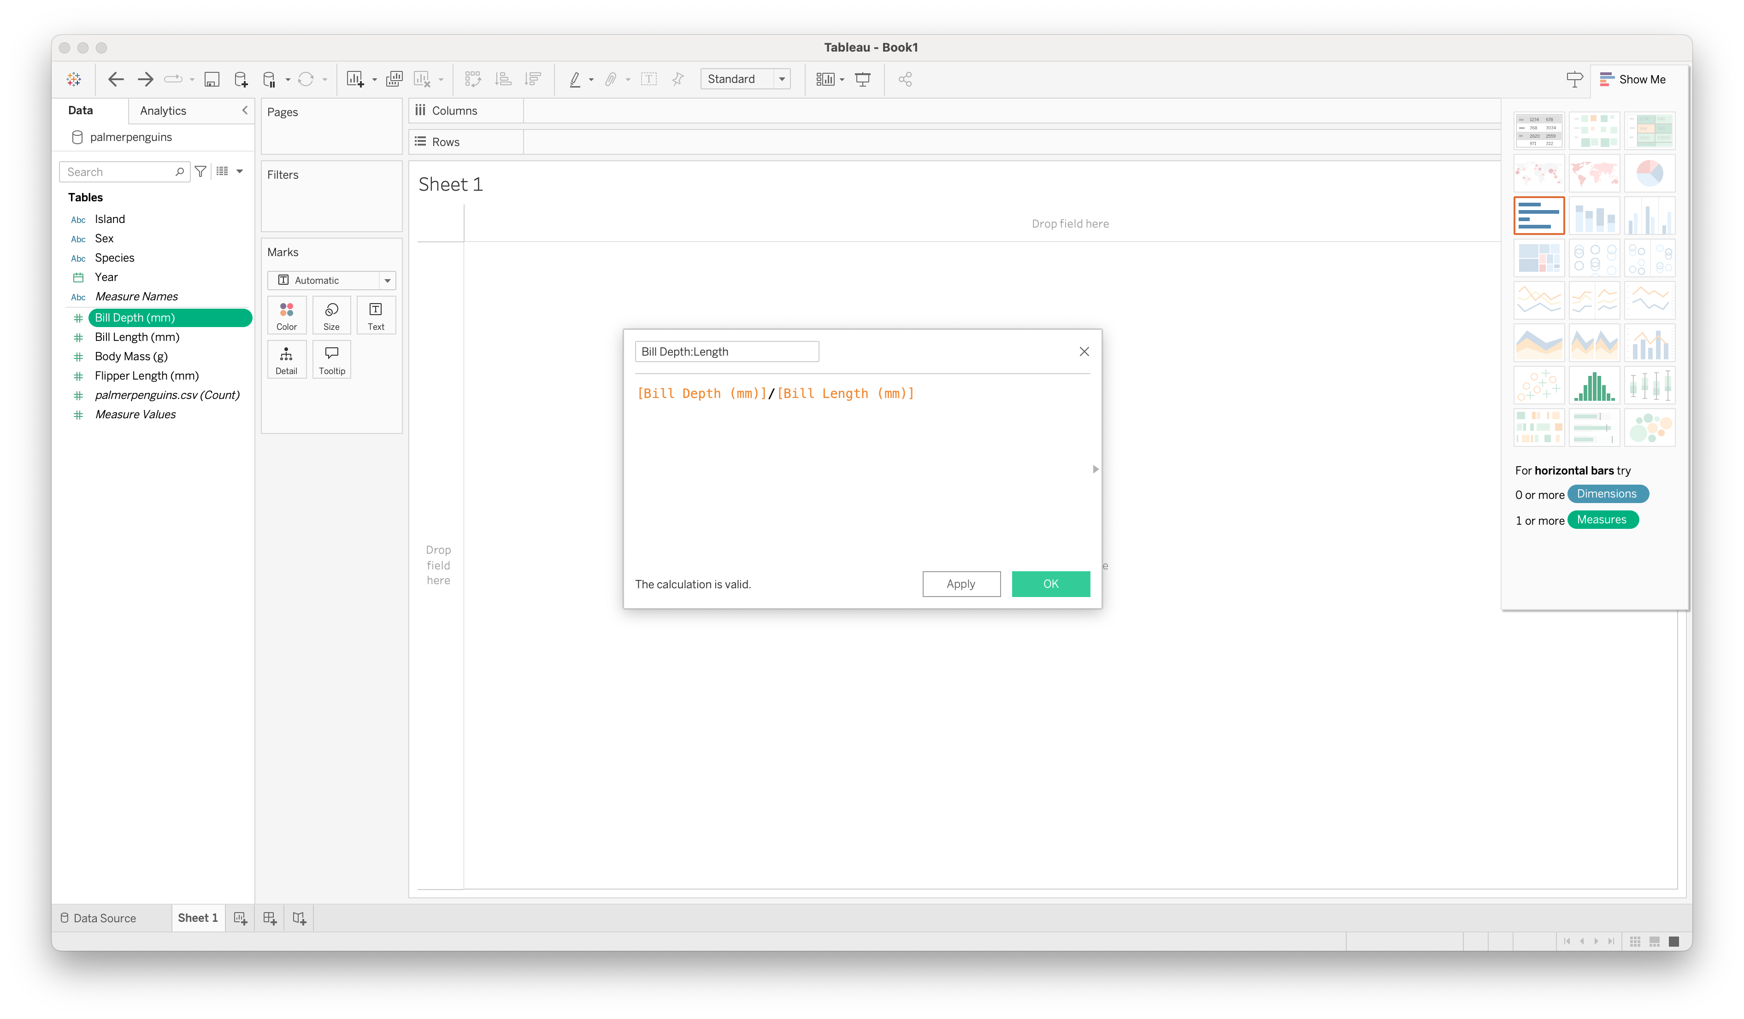
Adding Measures
Tableau basics

Slide 20
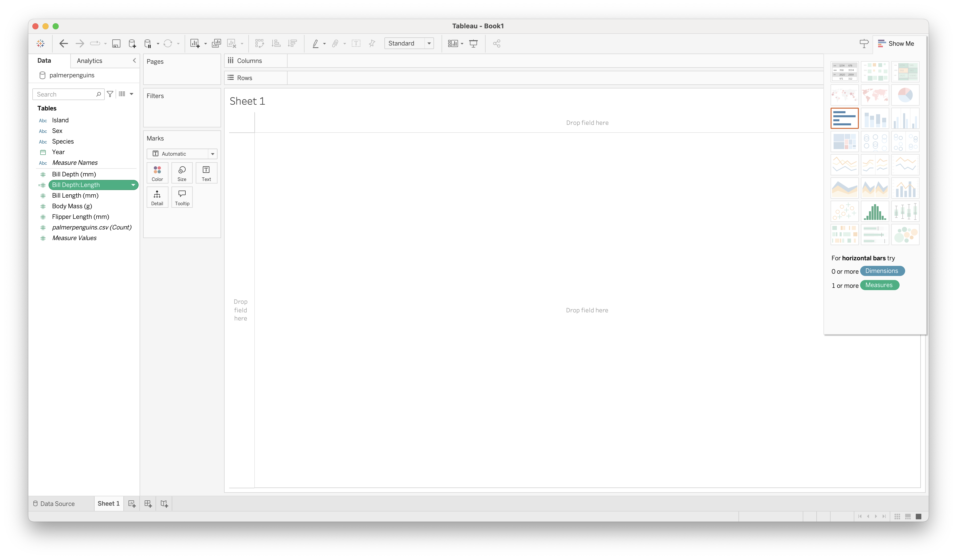
Adding Measures
Tableau basics
Try Groups and Bins as well!

Slide 21
Visualizing Data
Tableau basics

Slide 22
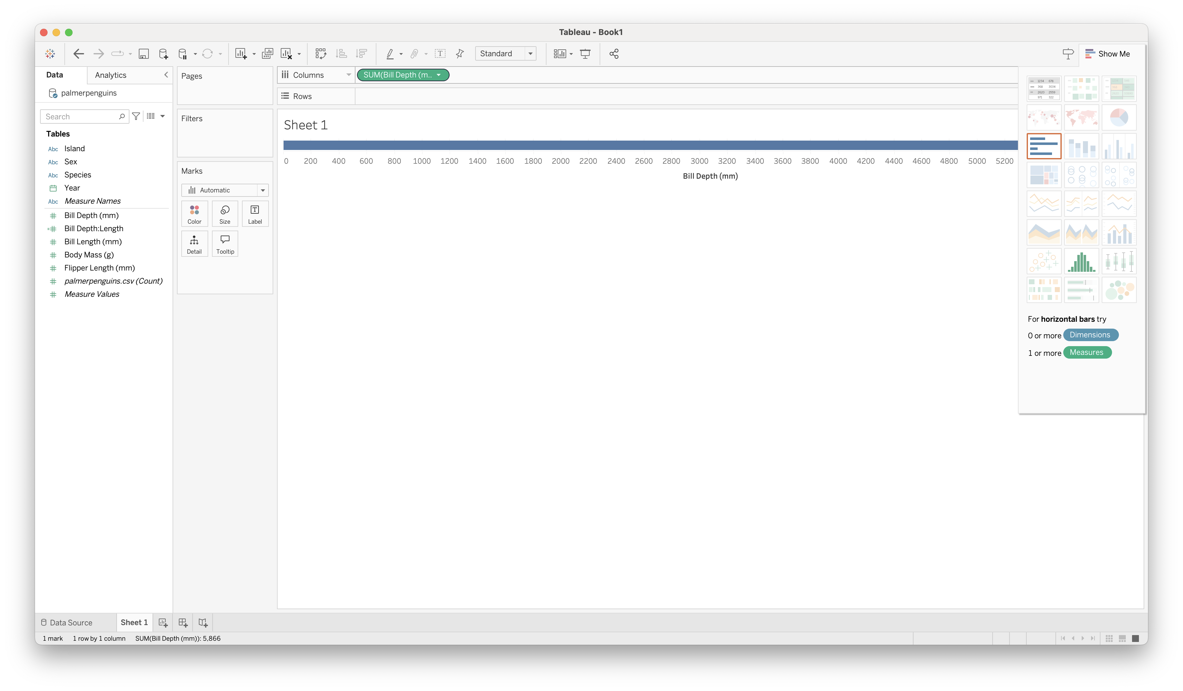
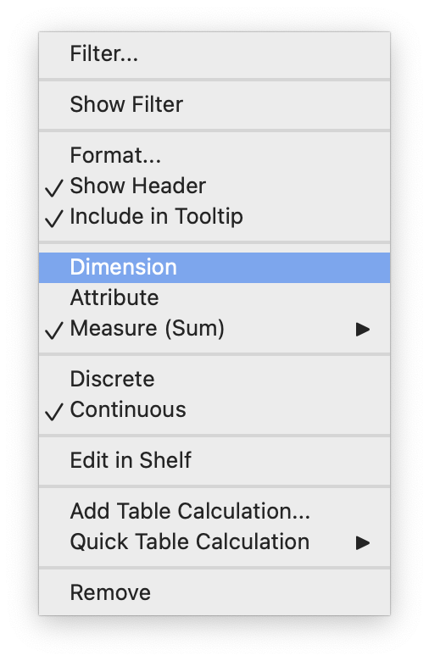
Visualizing Data
Tableau basics

Slide 23
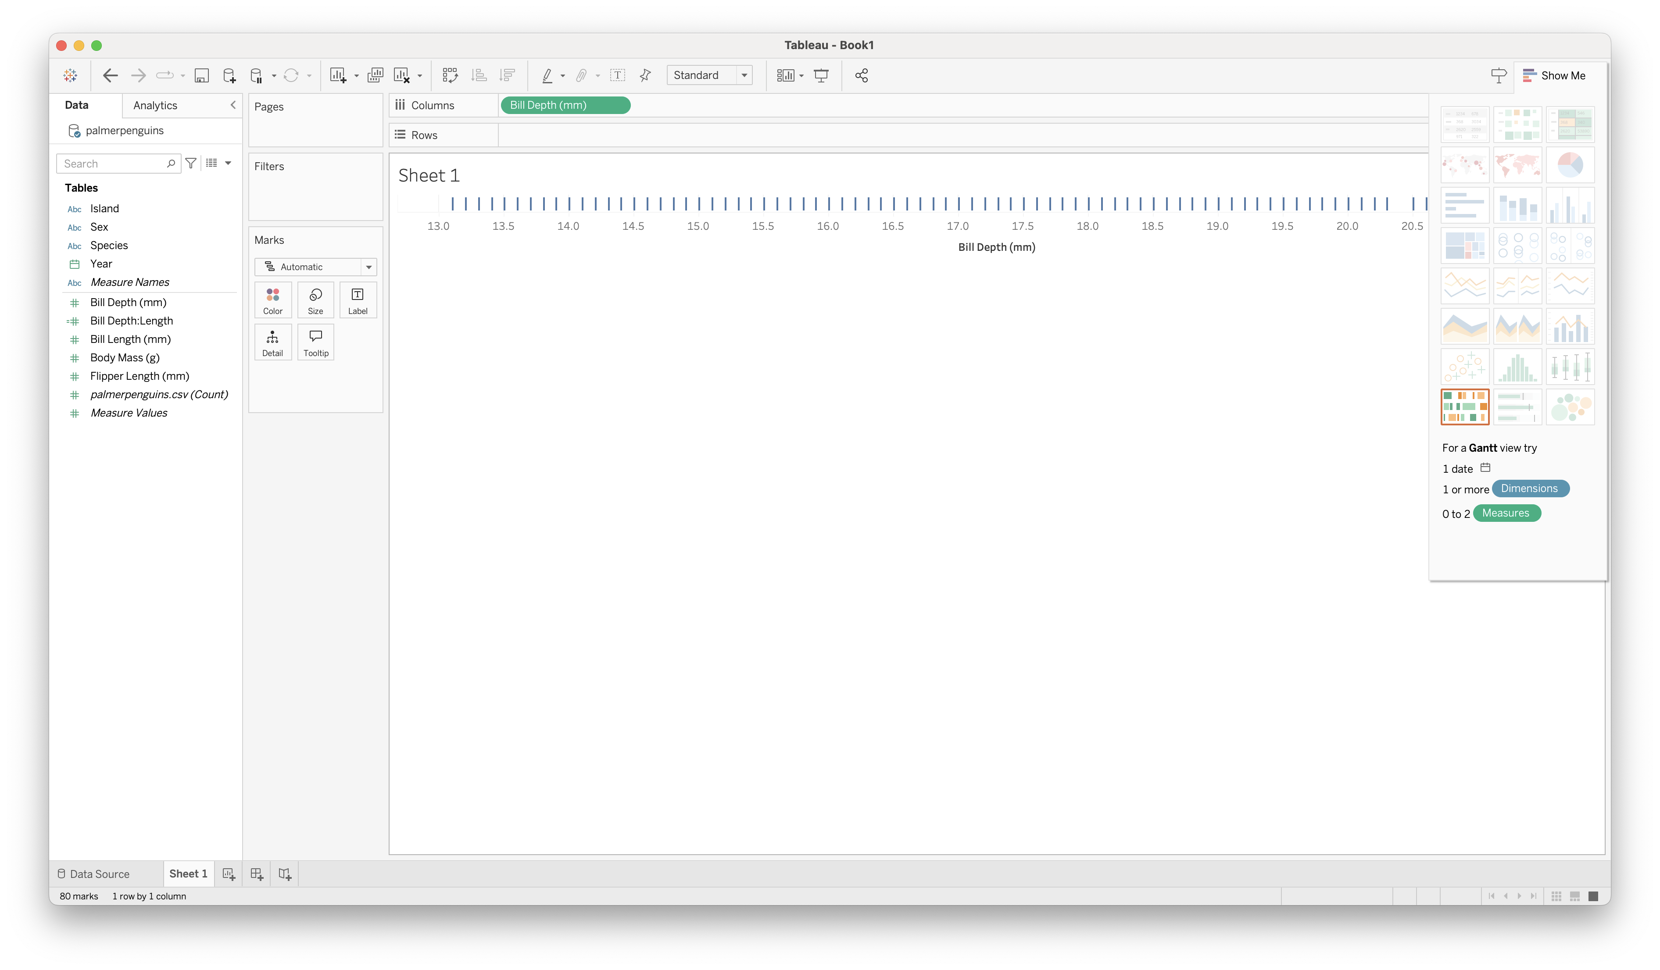
Visualizing Data
Tableau basics

Slide 24
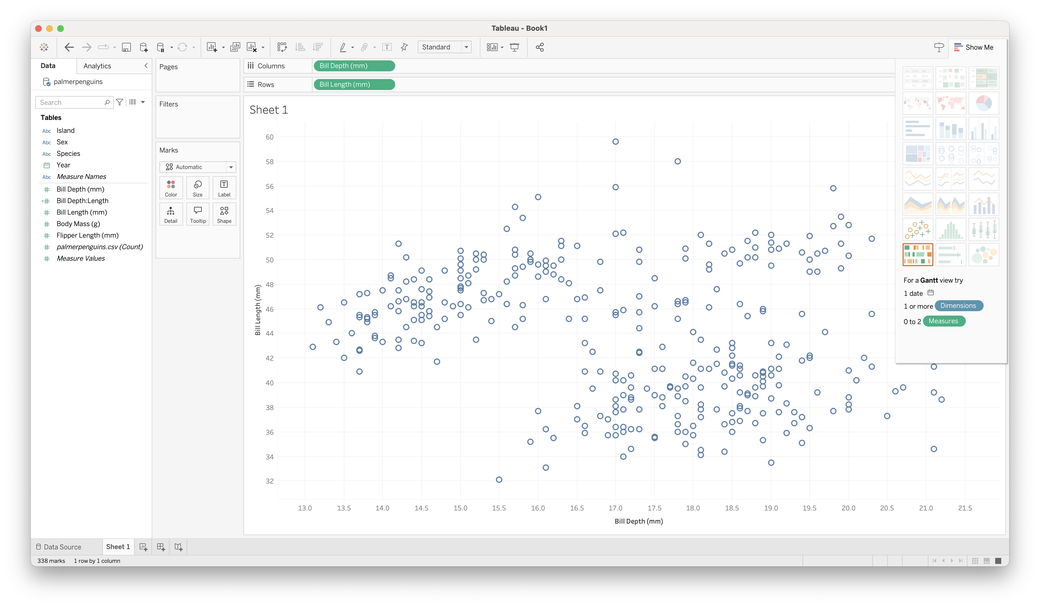
Visualizing Data
Tableau basics

Slide 25
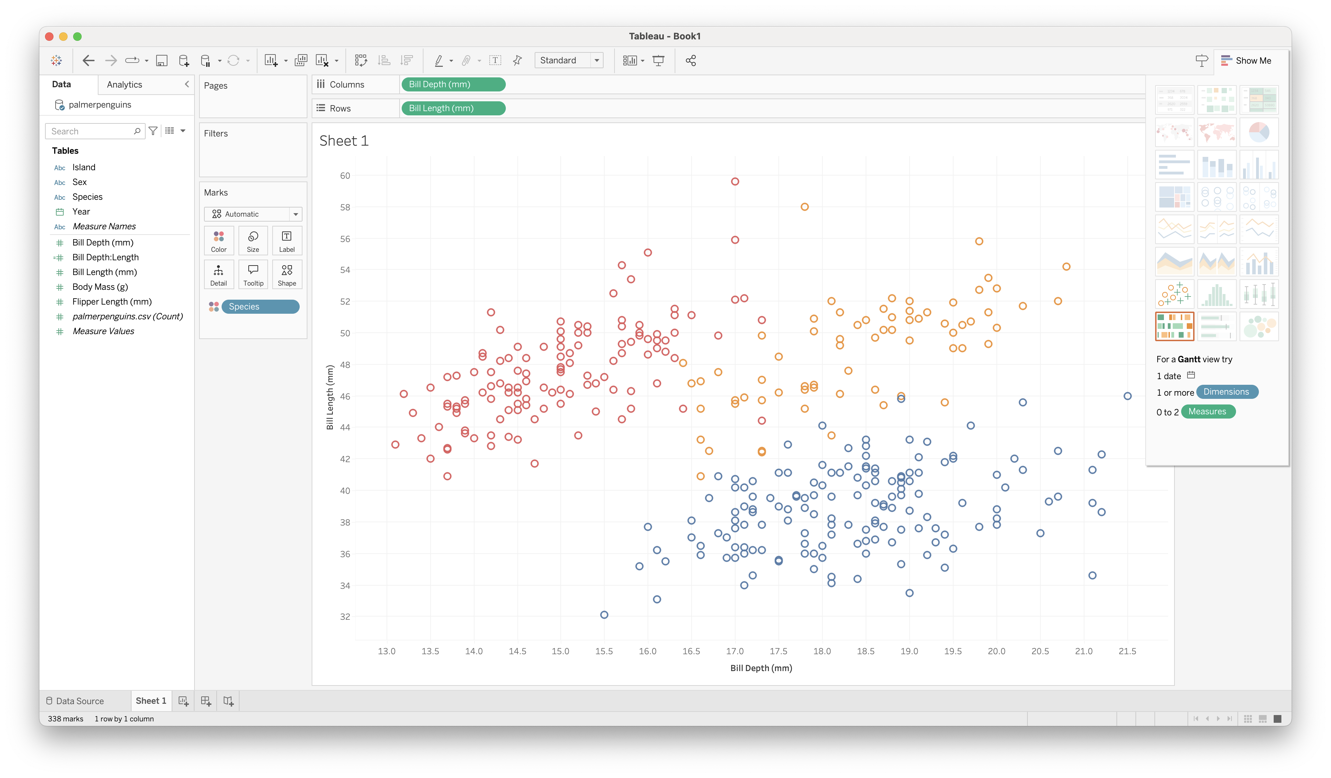
Visualizing Data
Tableau basics

Slide 26
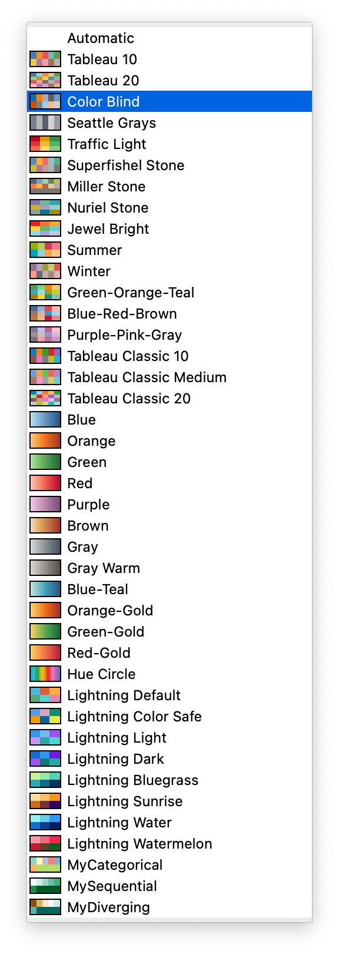
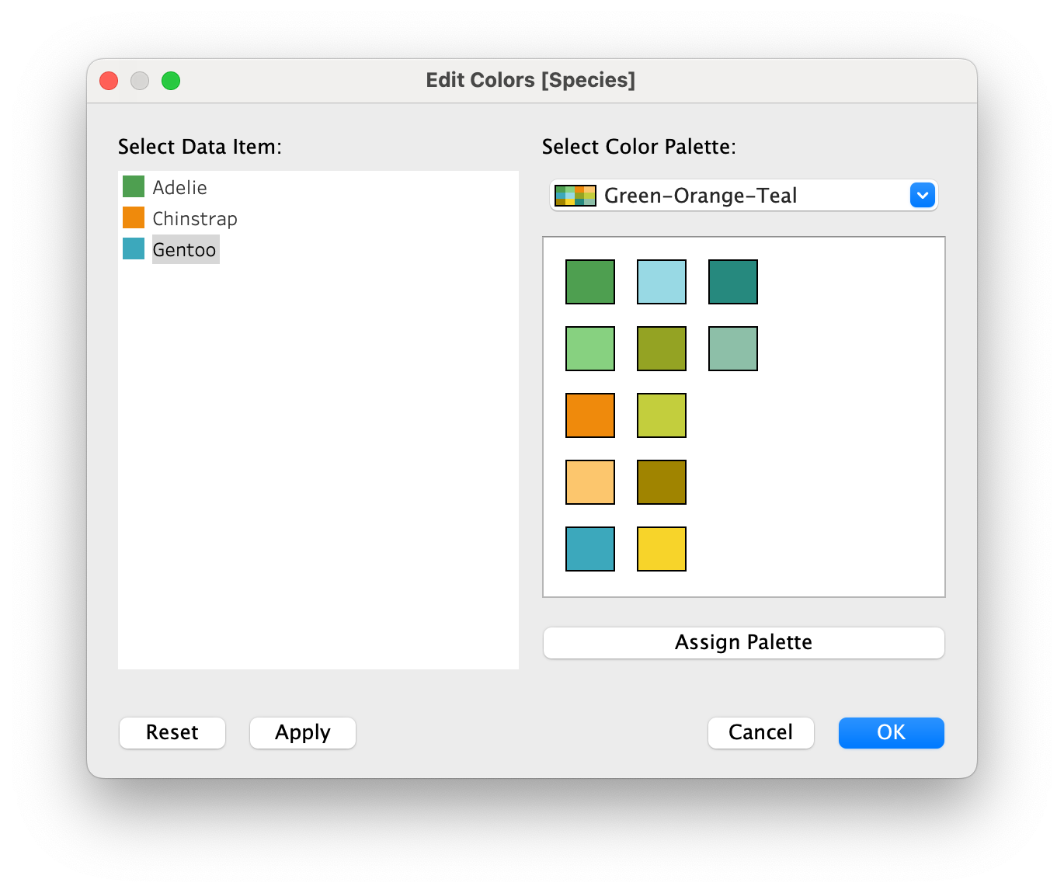
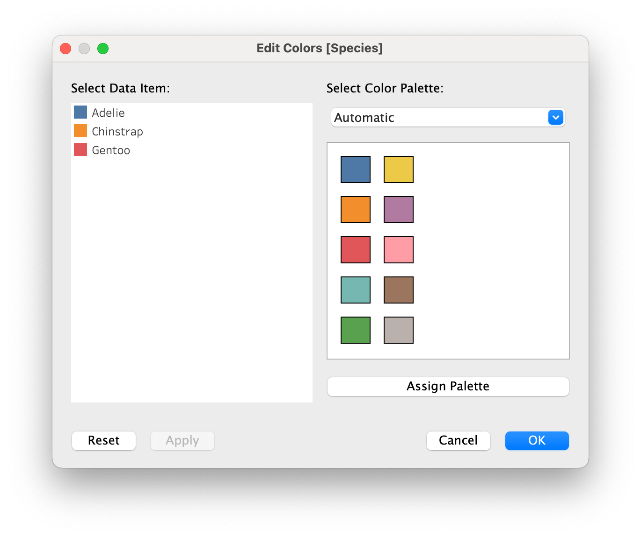
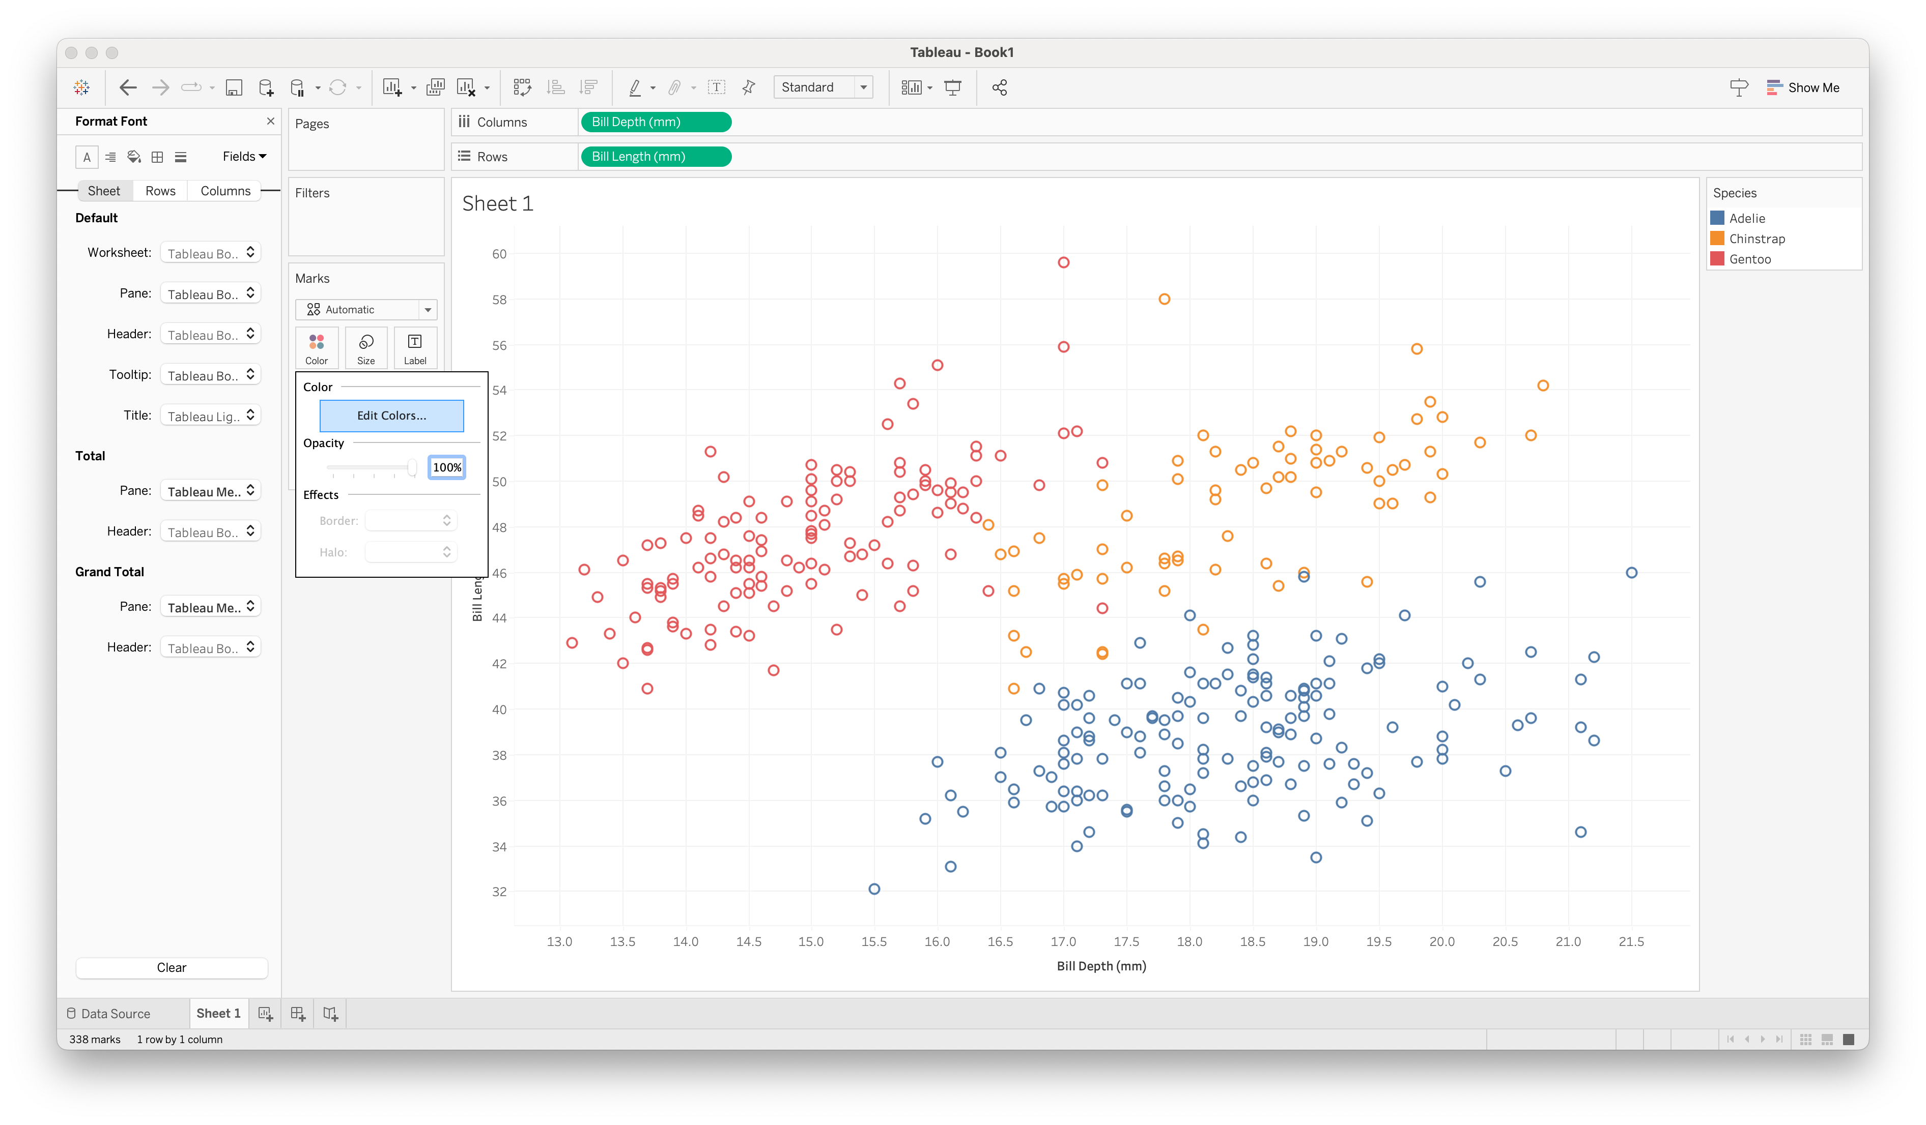
Visualizing Data
Tableau basics

Slide 27
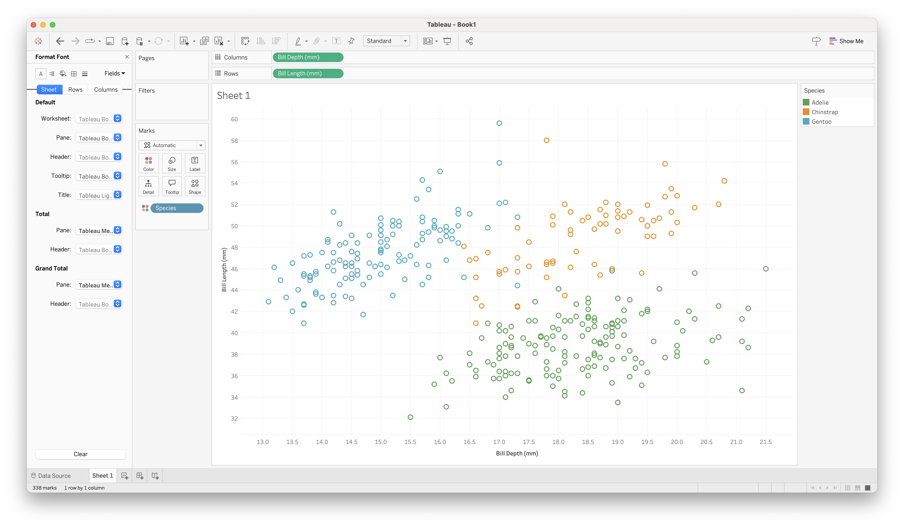
Visualizing Data
Tableau basics

Slide 28
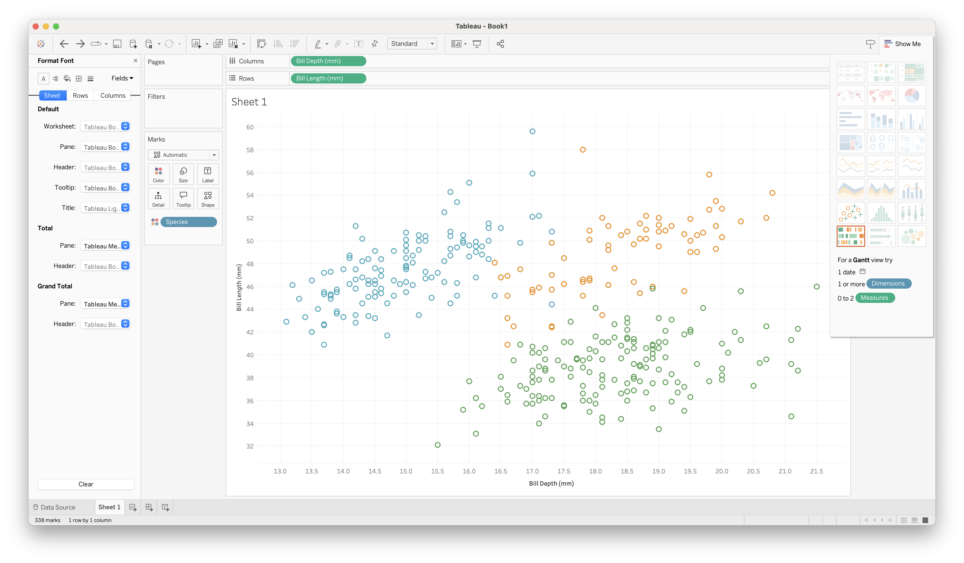
Show Me
Tableau basics

Slide 29
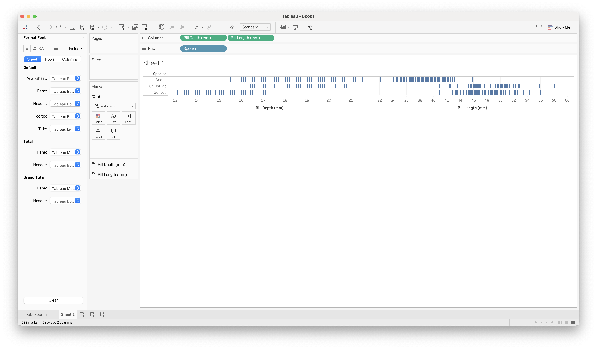
Show Me (not all options are good ideas!)
Tableau basics

Slide 30
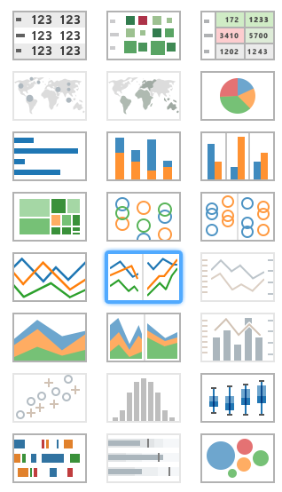
21 Available Views
Tableau basics
Tables
Maps
Pie charts
Bar charts
Treemaps
Circle views
Line charts
Area charts
Combination charts
Scatterplots
Histograms
Box-and-whisker plots
Gantt
Bullet plots
Packed circles

Slide 31
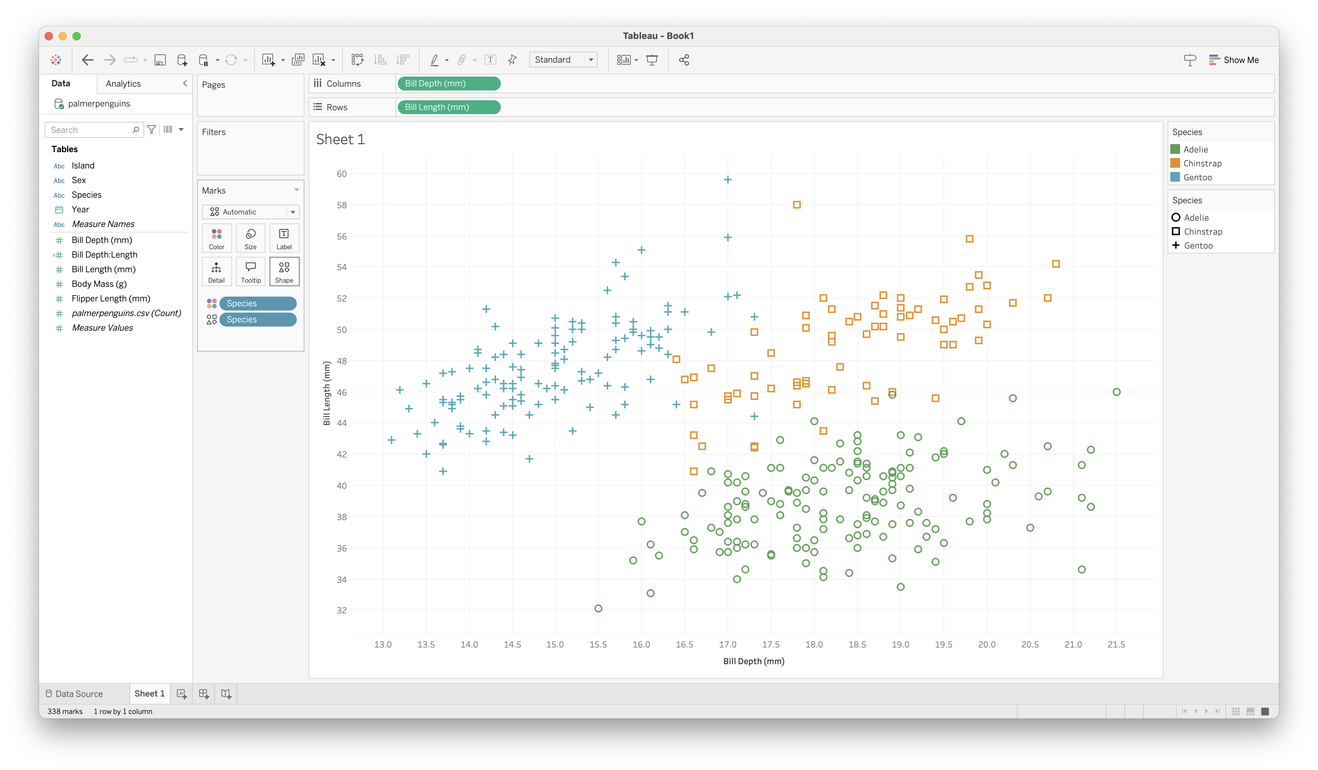
Dual Encoding
Tableau basics

Slide 32
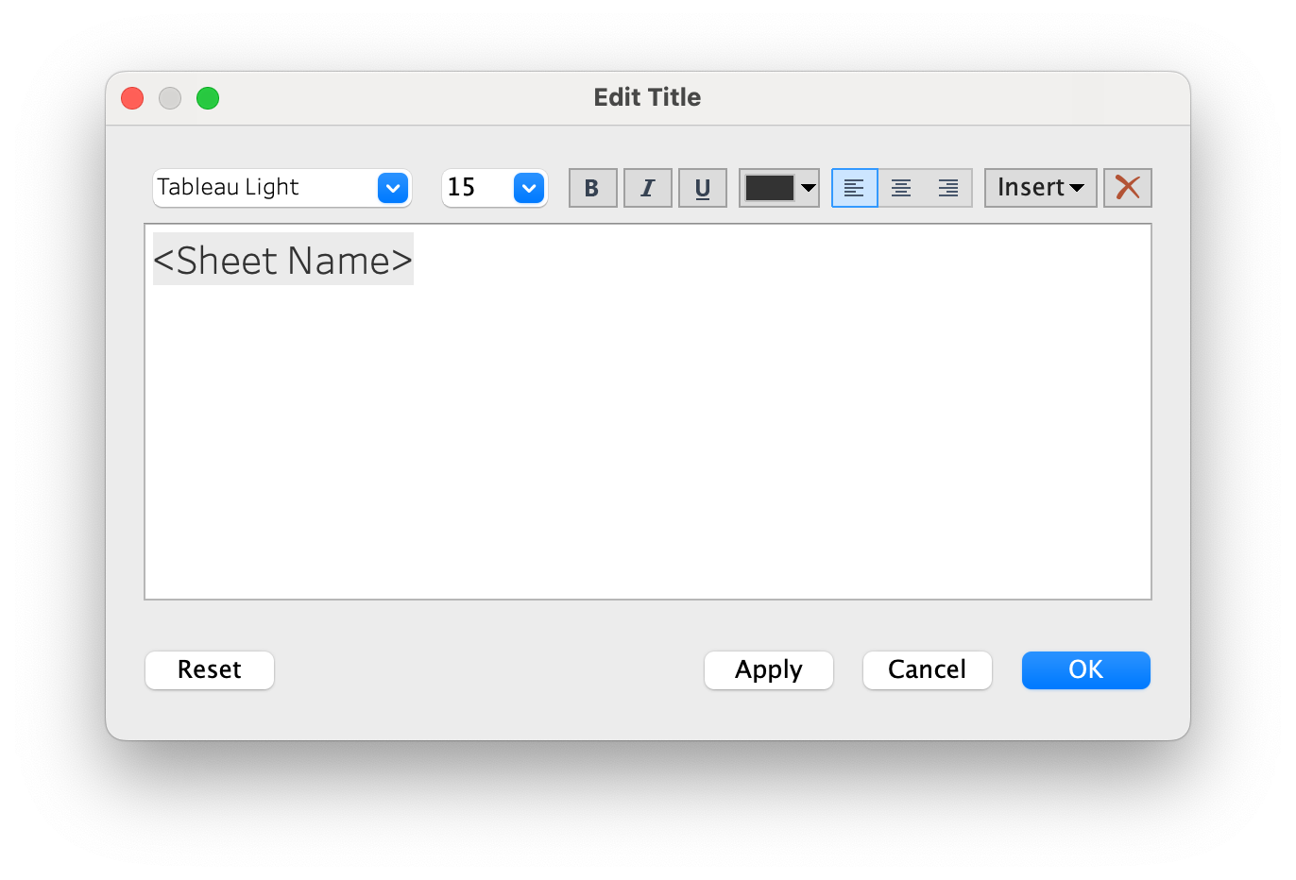
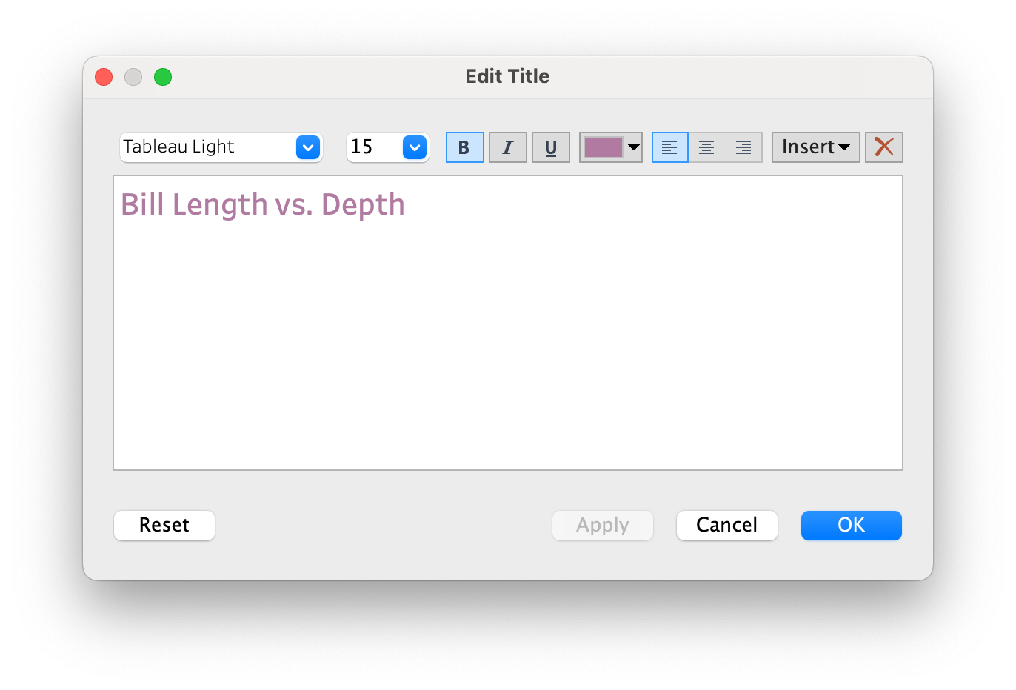
Title
Tableau basics

Slide 33

Title
Tableau basics

Slide 34

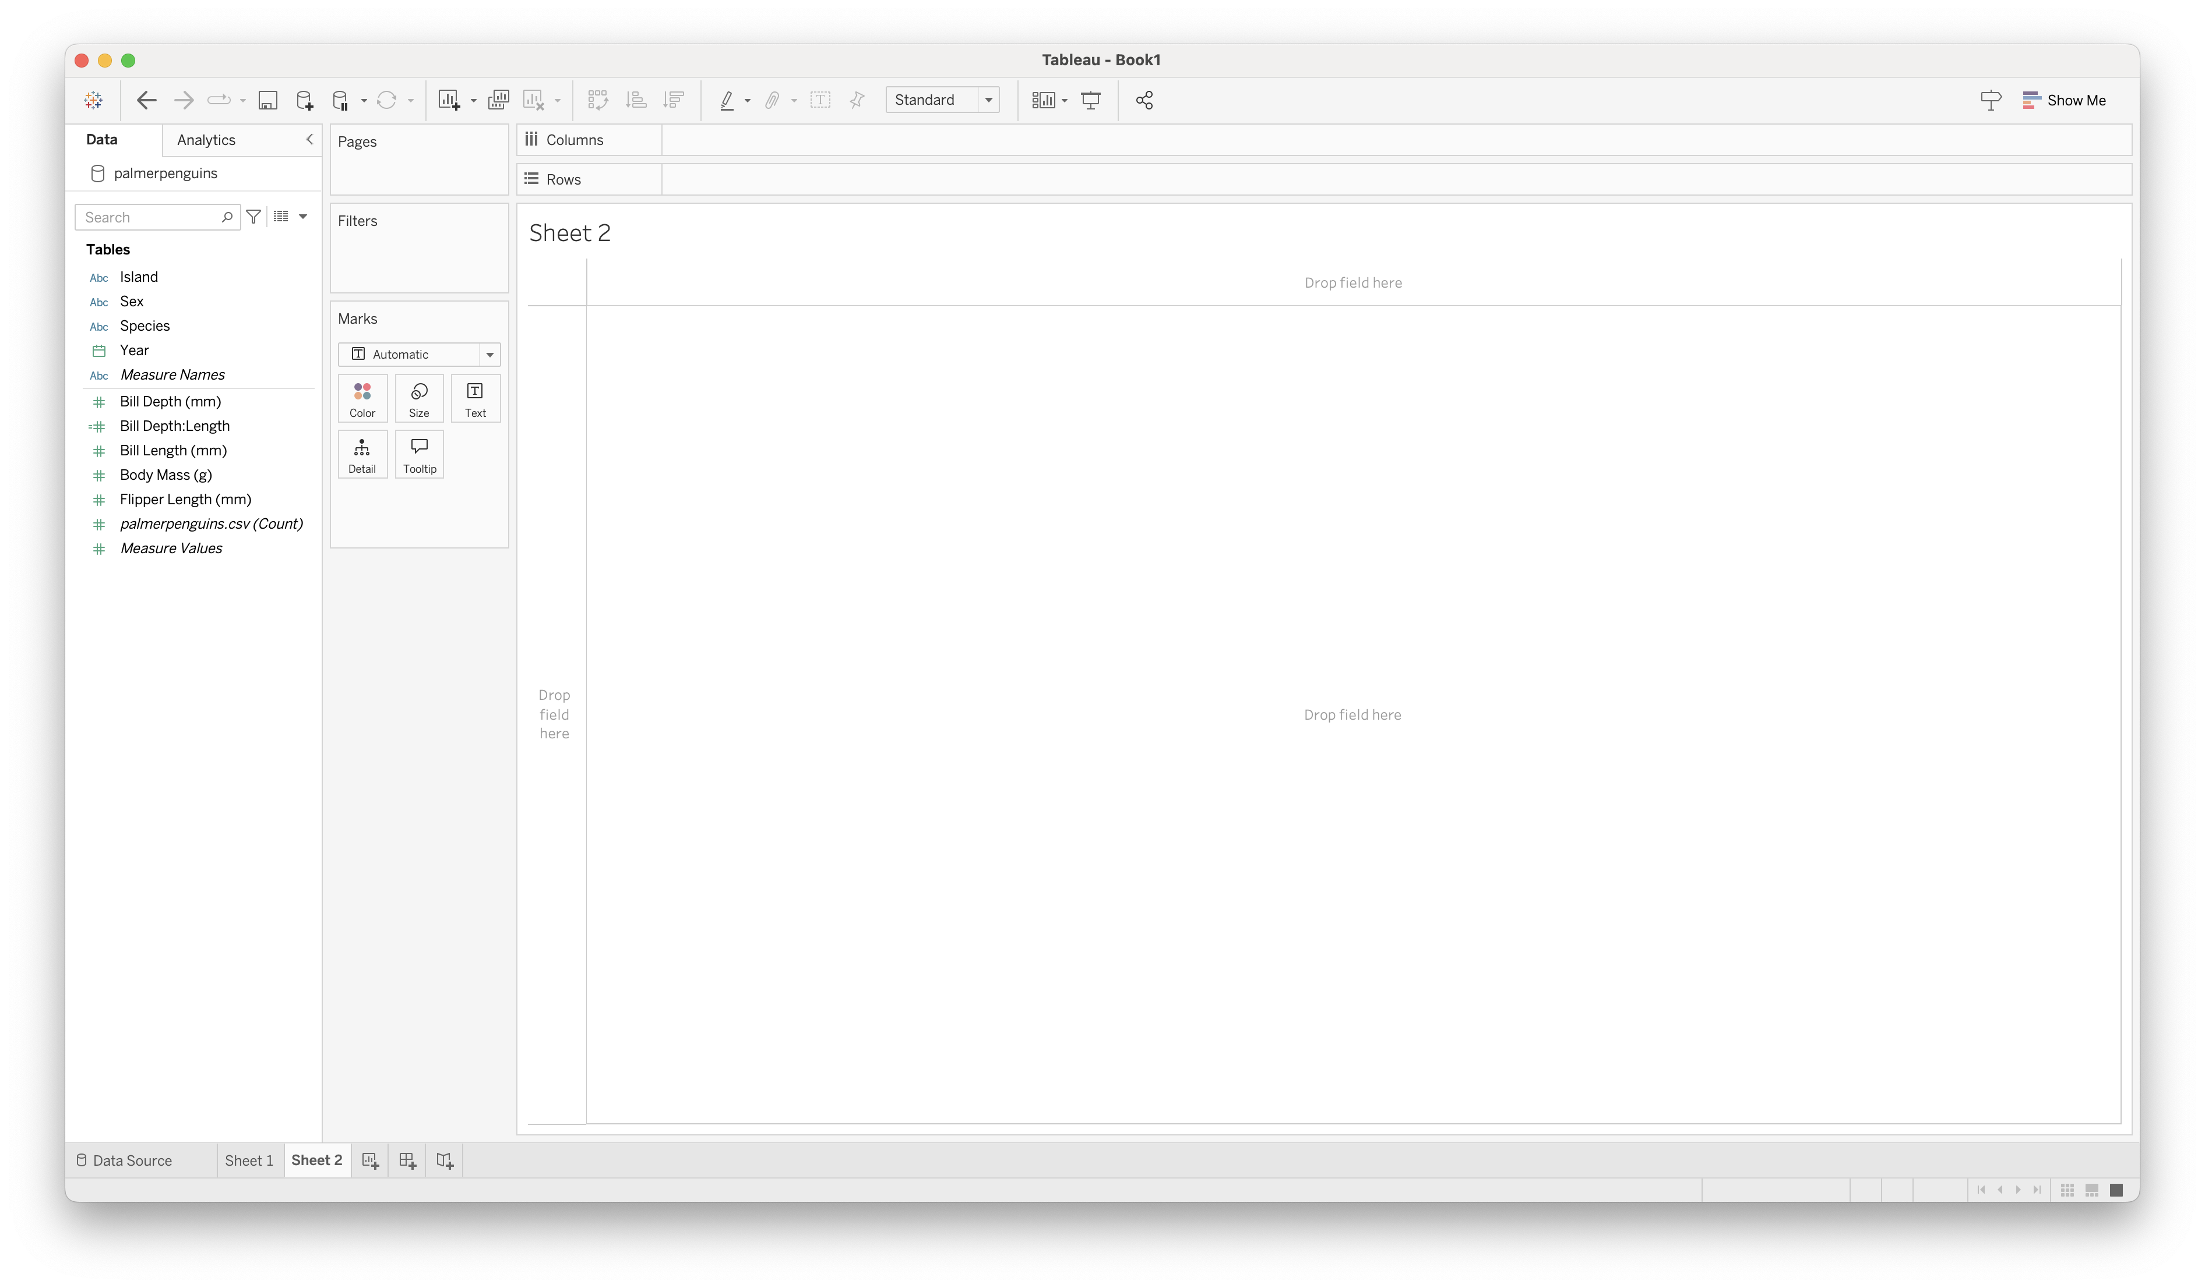
Creating a new sheet
Tableau basics

Slide 35
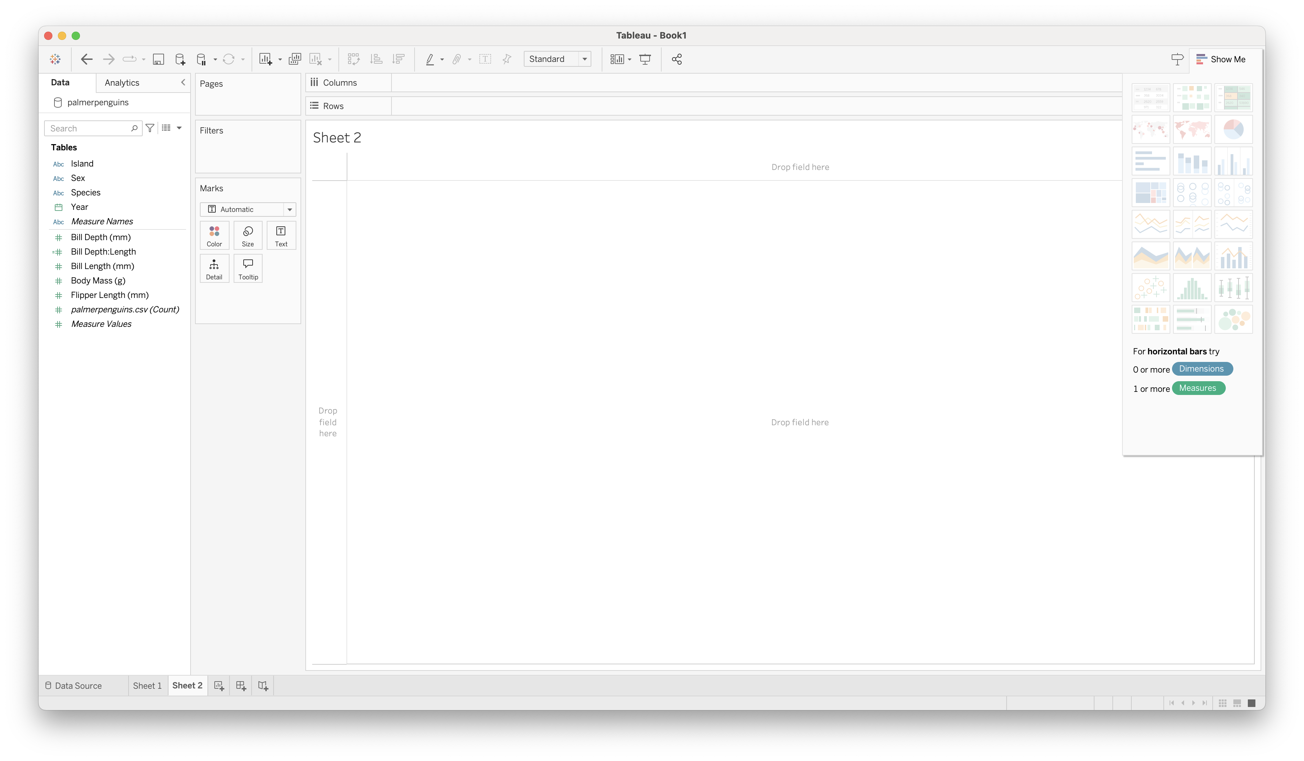
Show Me
Tableau basics

Slide 36

Show Me
Tableau basics

Slide 37
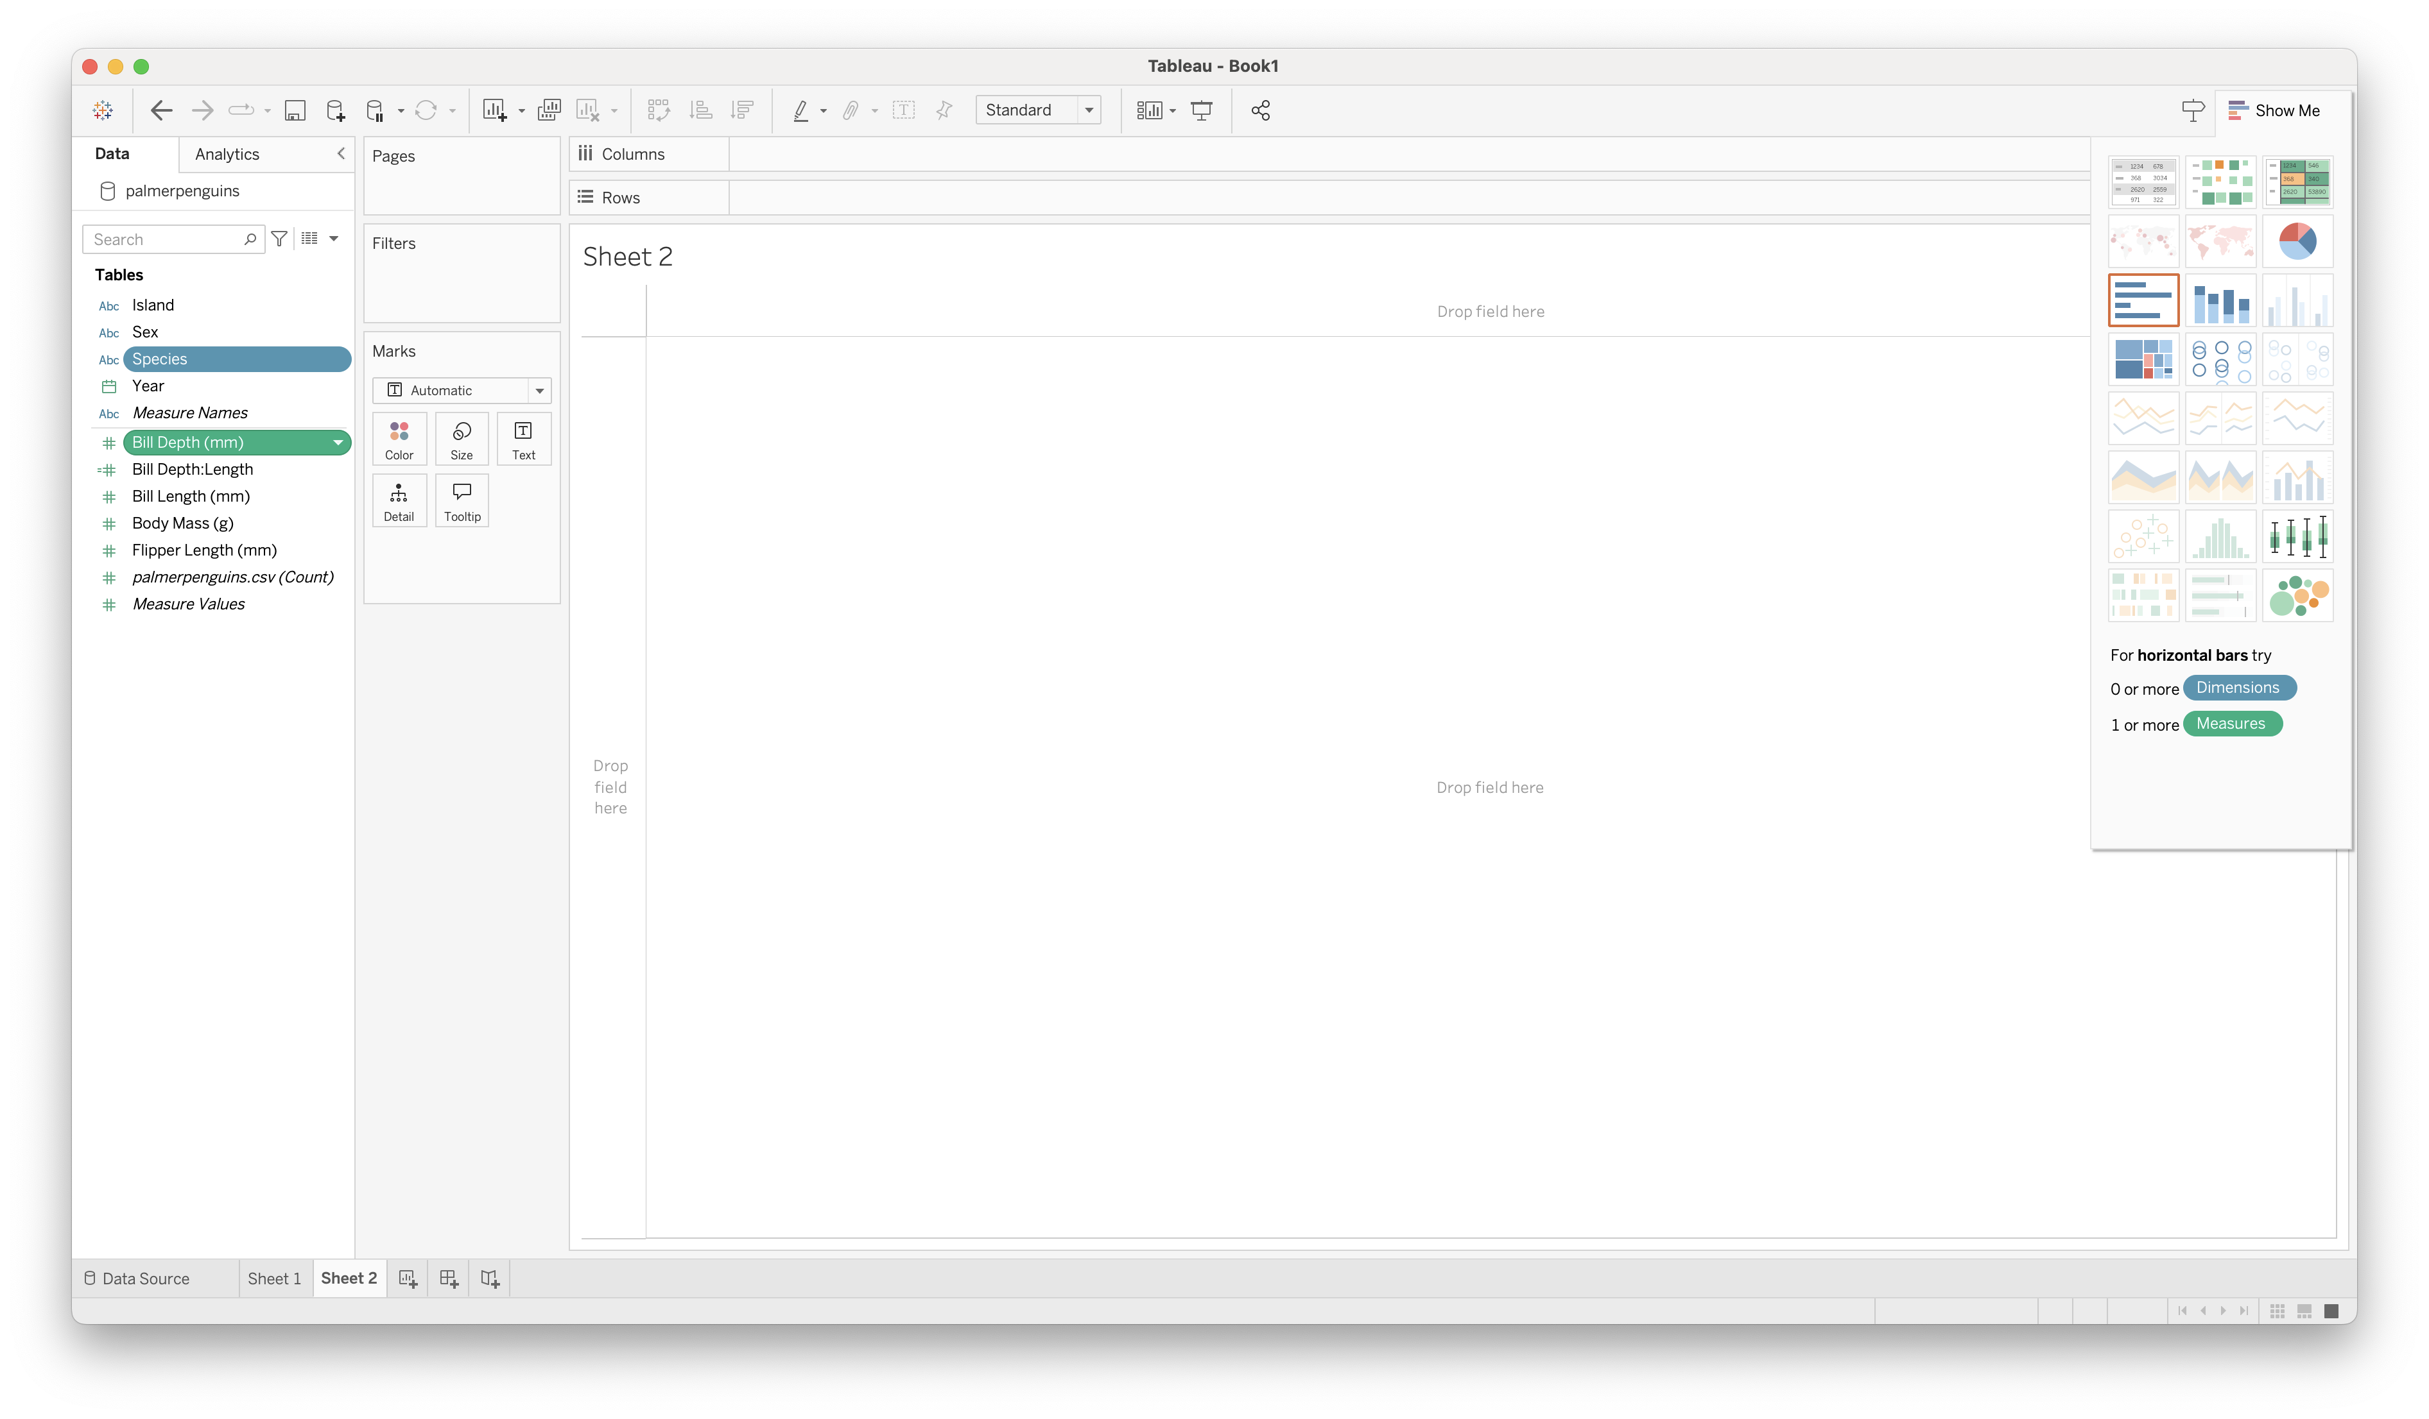
Show Me
Tableau basics

Slide 38
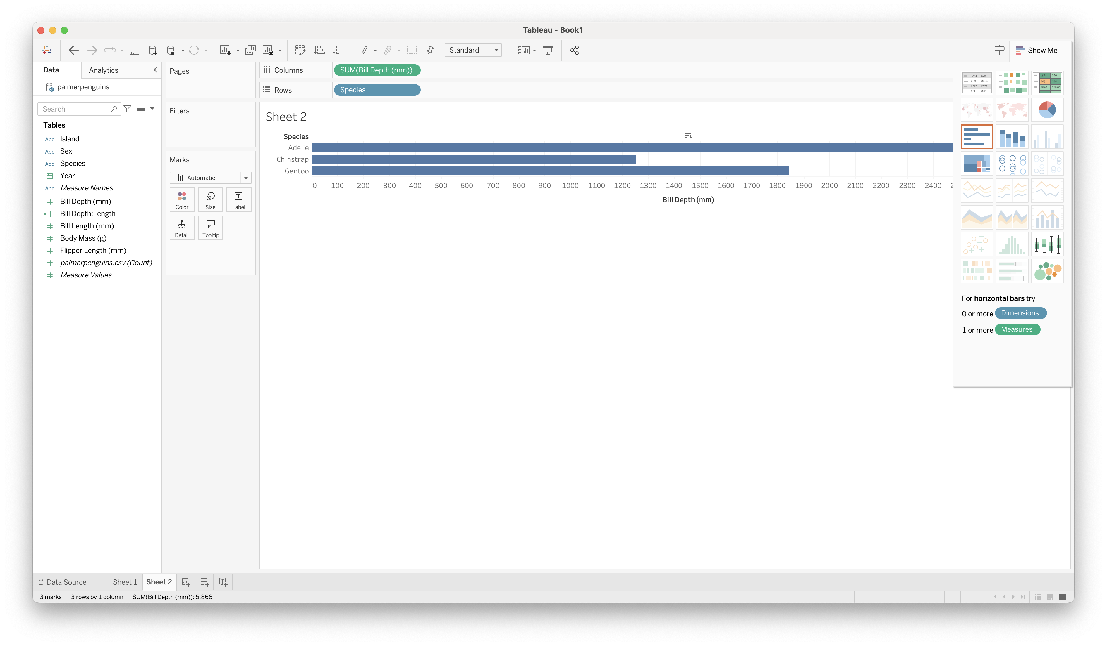
Show Me
Tableau basics

Slide 39

Building Stories from Multiple Views
Tableau basics

Slide 40
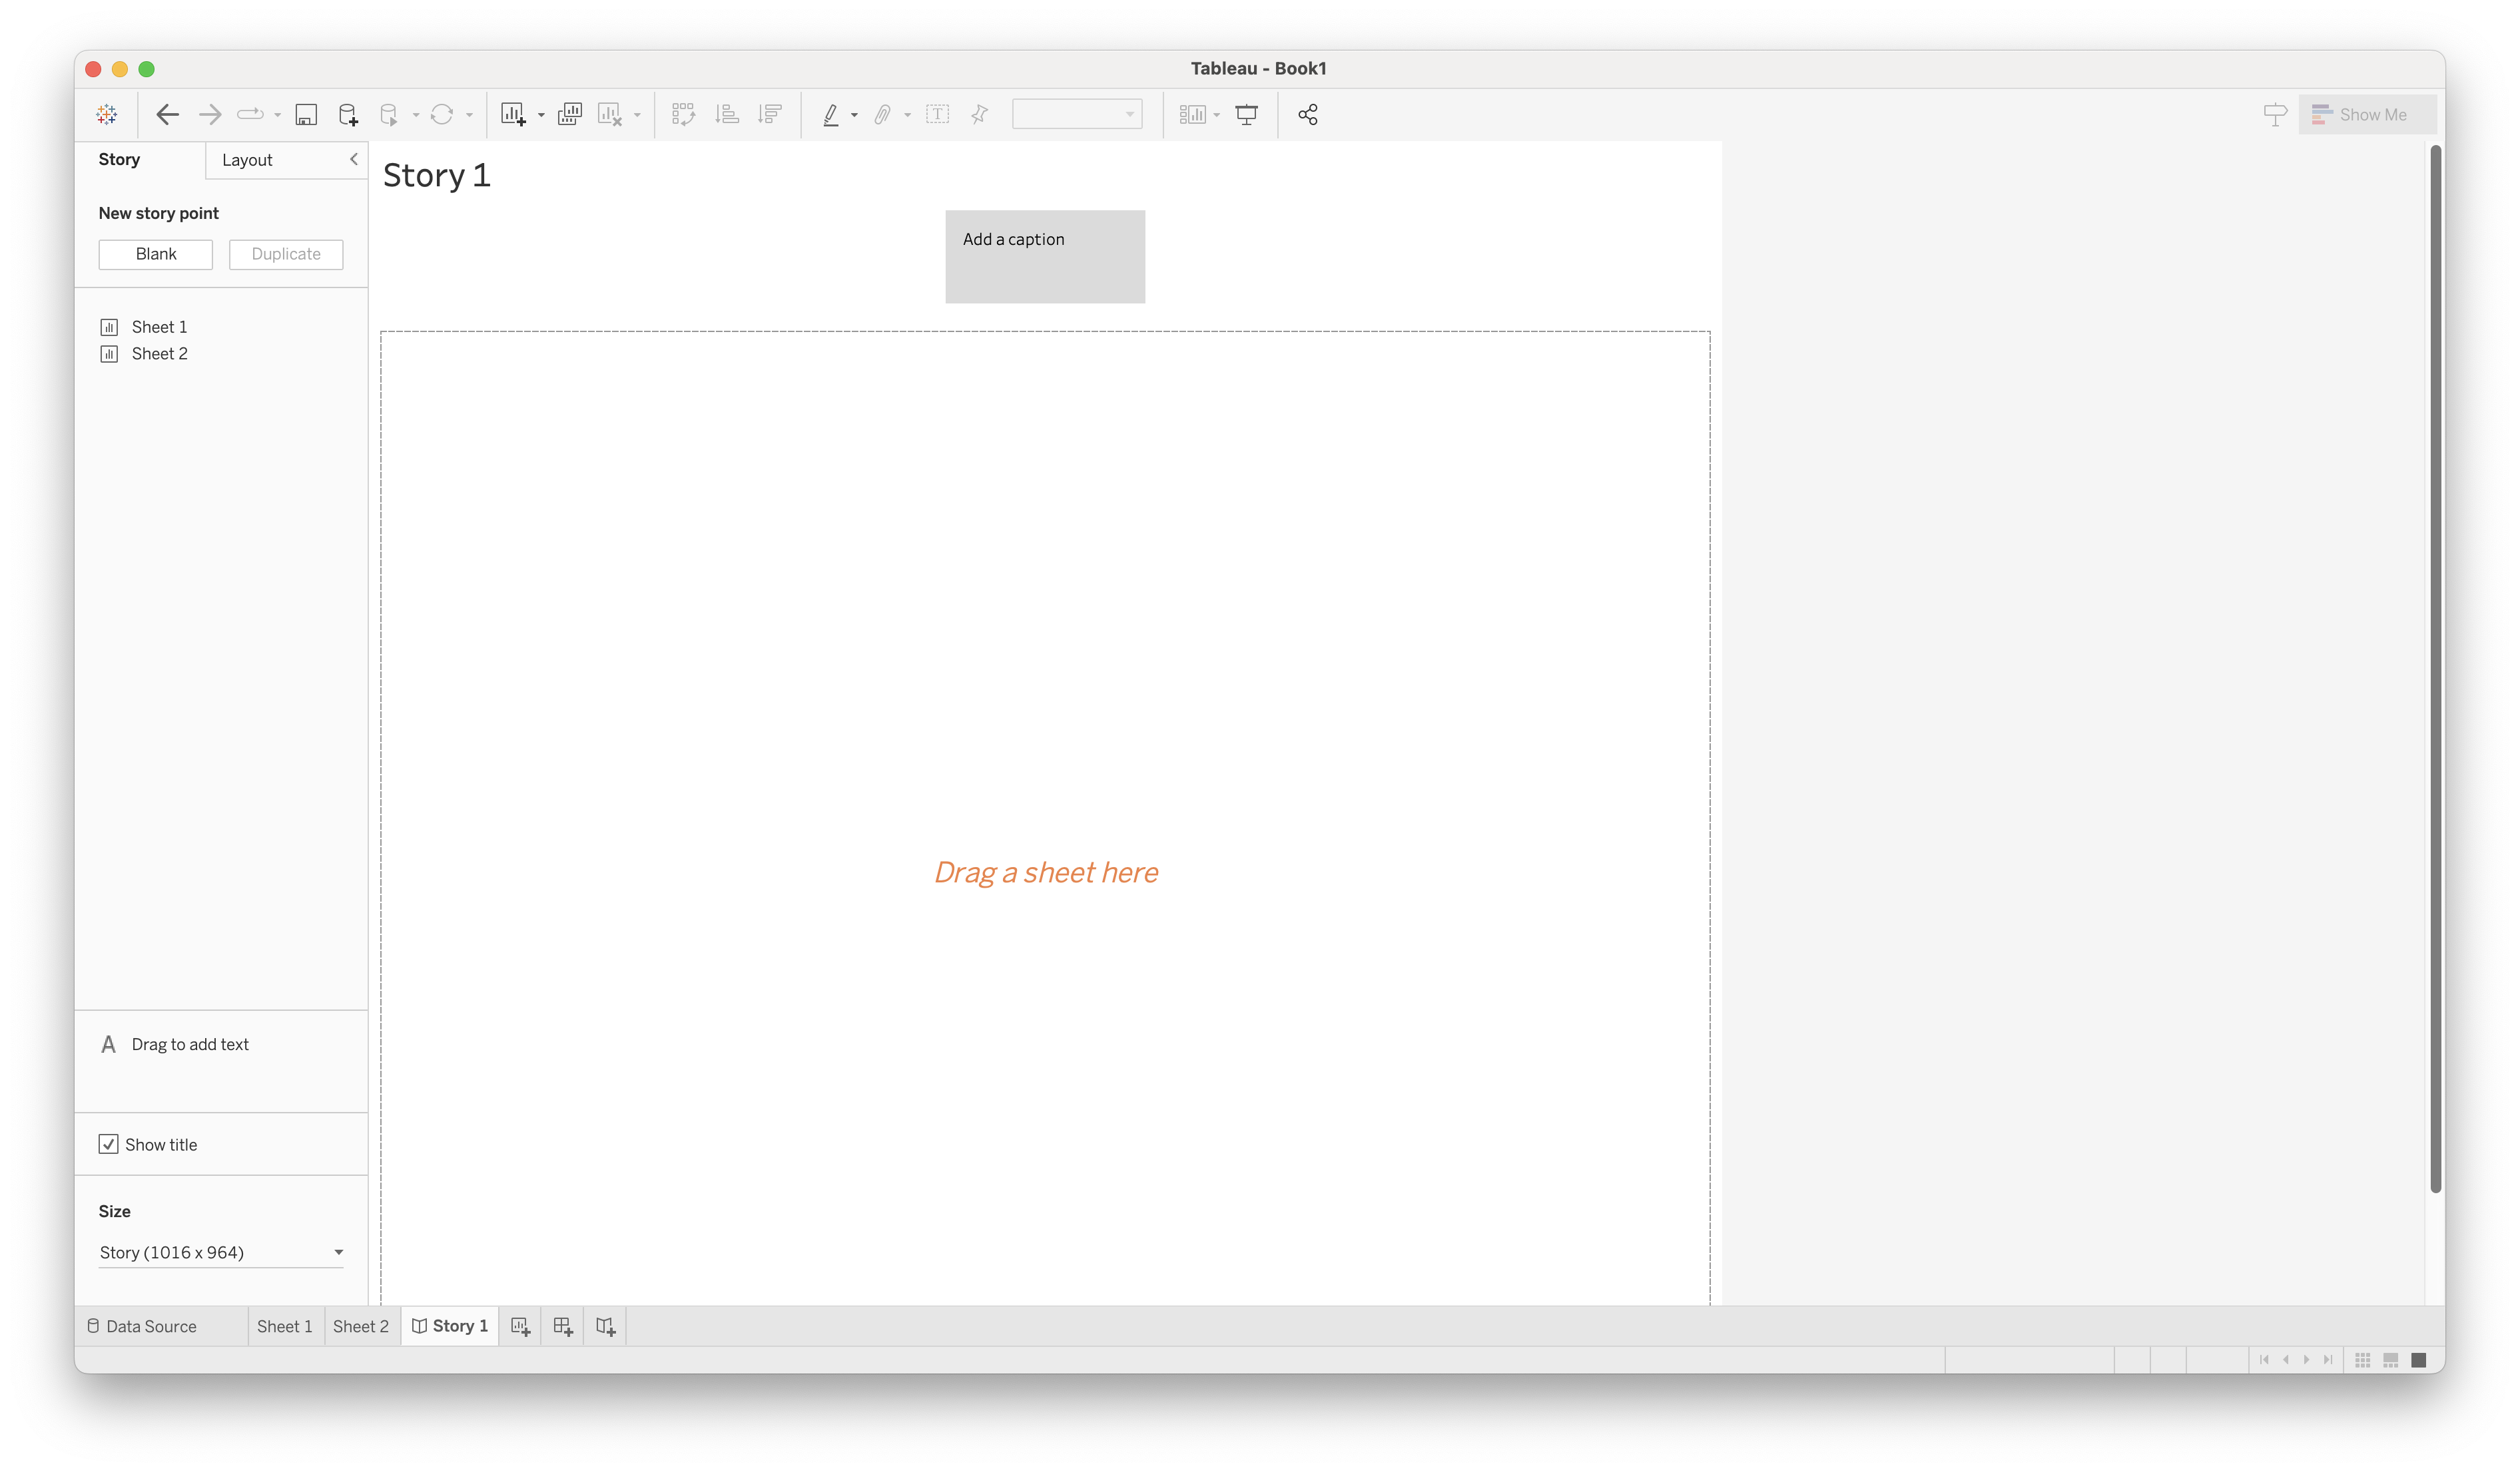
Building Stories from Multiple Views
Tableau basics

Slide 41
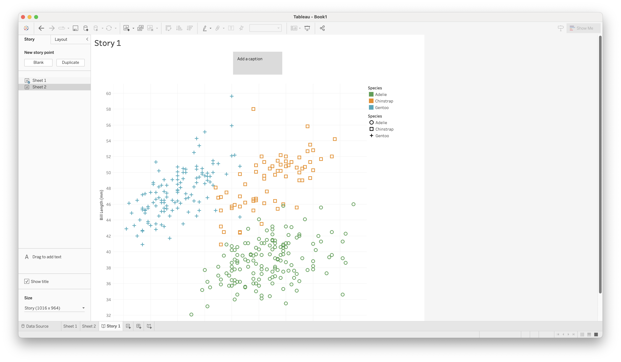
Building Stories from Multiple Views
Tableau basics

Slide 42
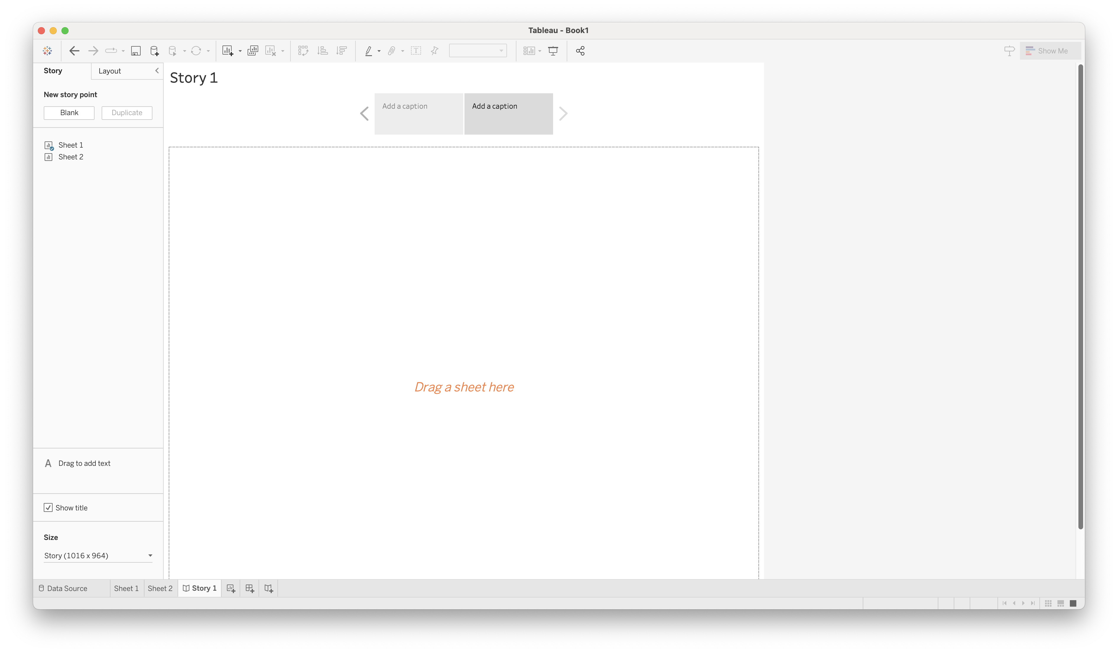
Building Stories from Multiple Views
Tableau basics

Slide 43
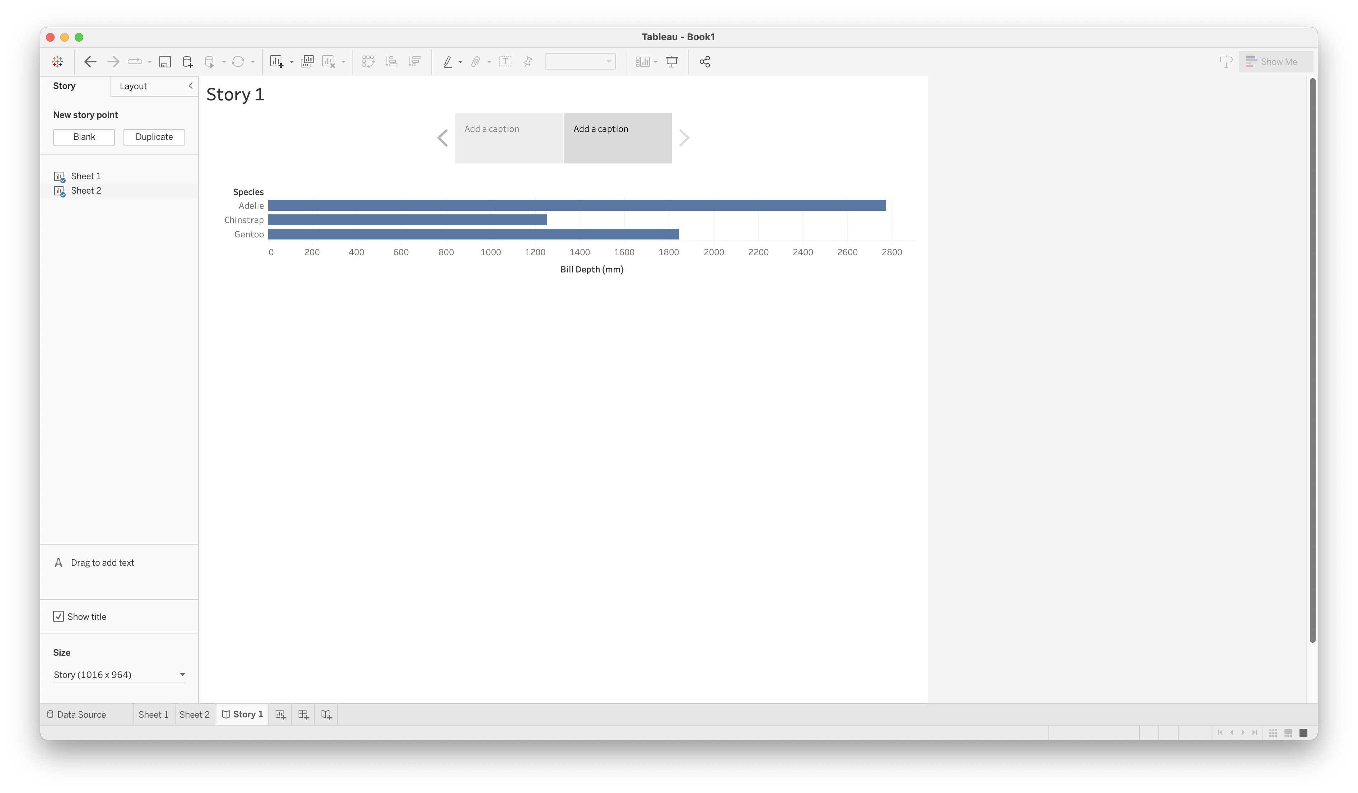
Building Stories from Multiple Views
Tableau basics

Slide 44
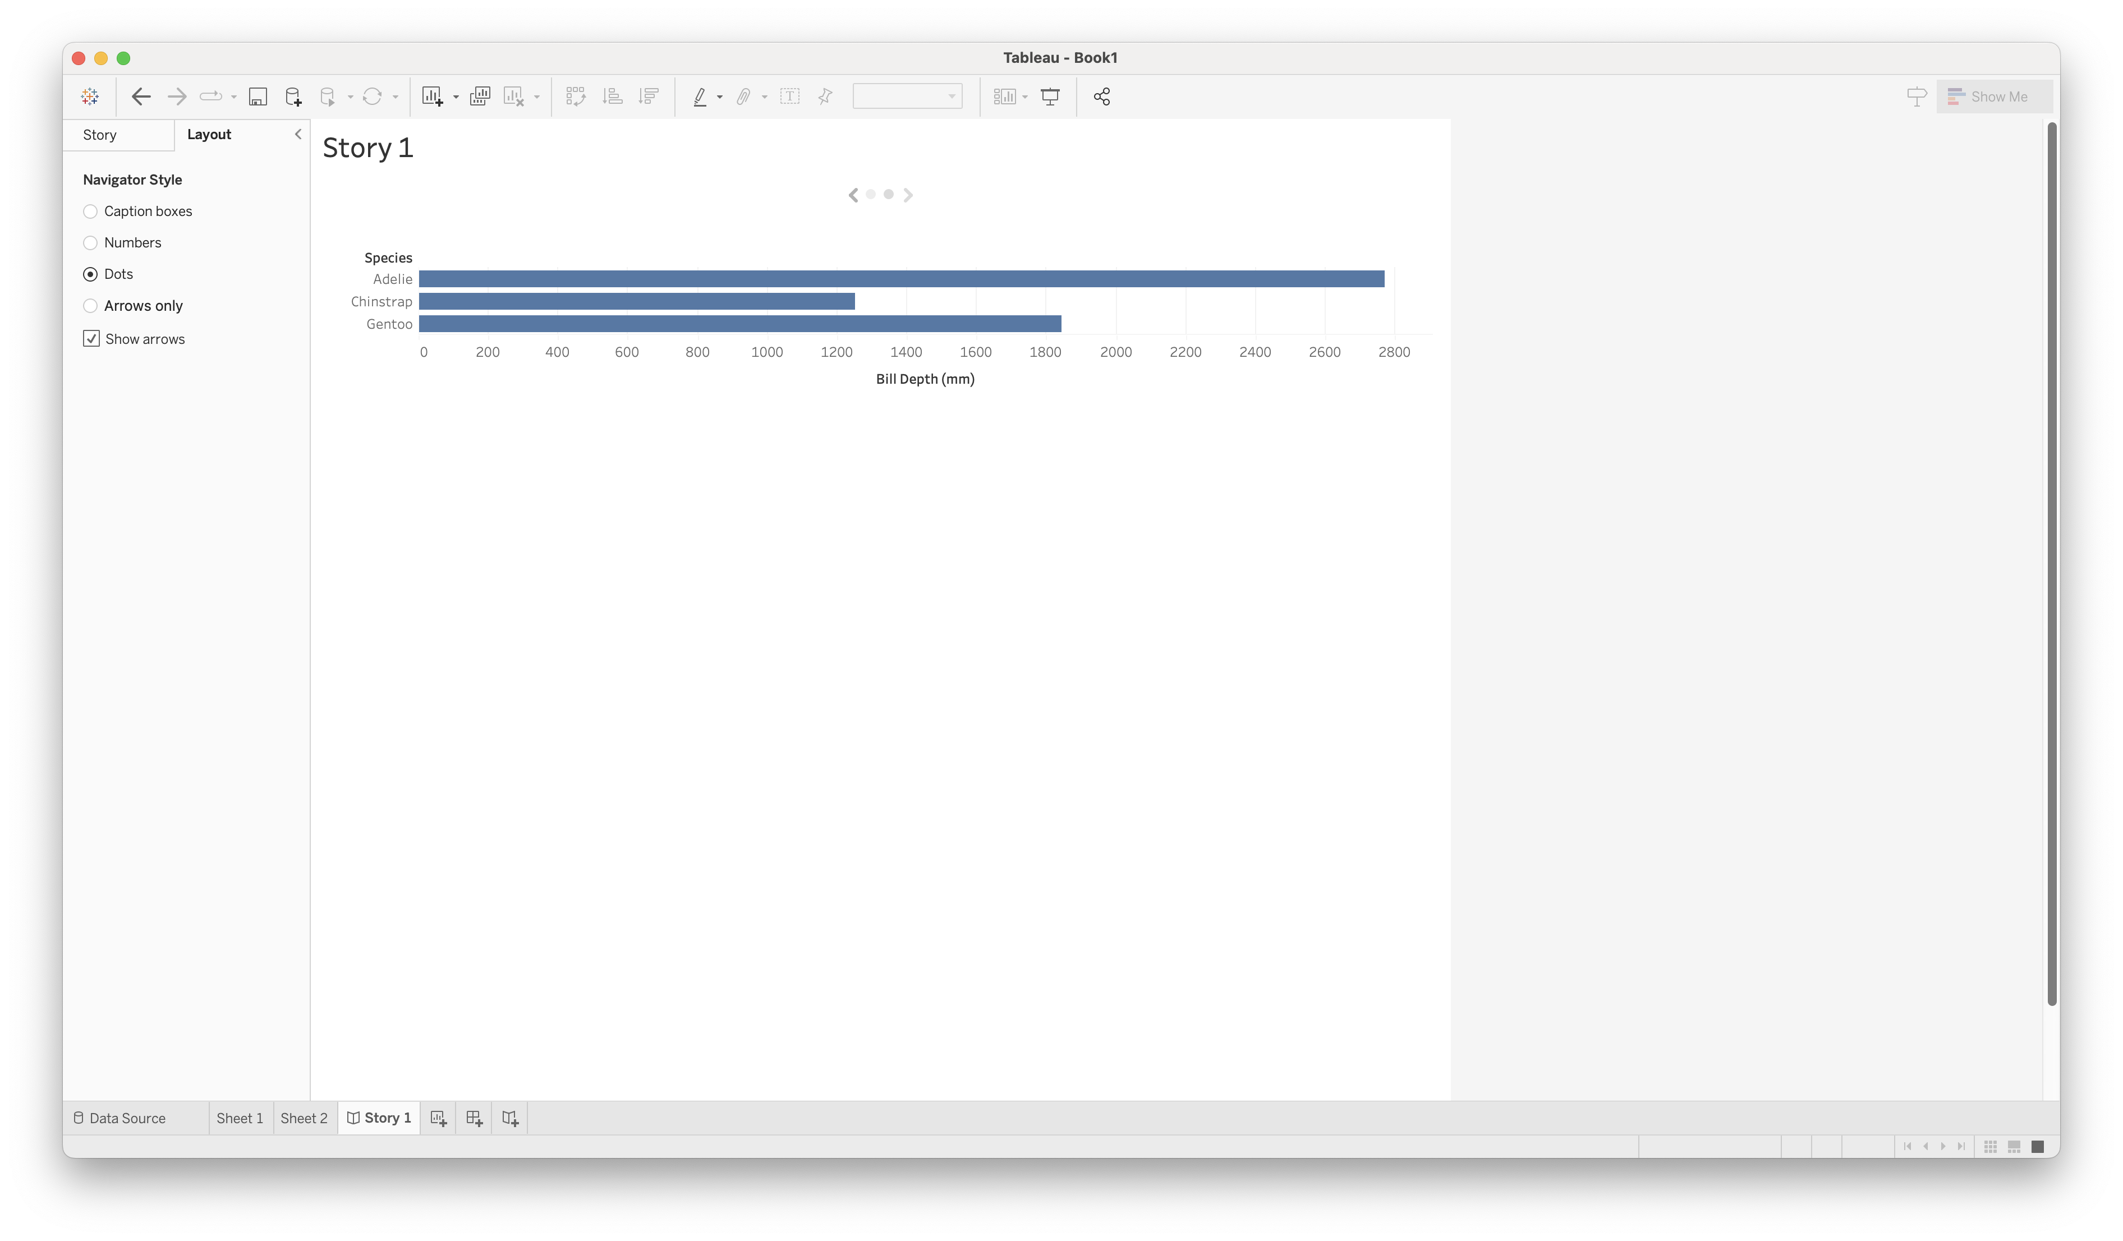
Building Stories from Multiple Views
Tableau basics

Slide 45
For an intro to:
Custom axes
Custom color pallets
Custom shapes
see tableau-demo-int.pdf under In-class on the course website.
Tableau basics

Slide 46
Form small groups
Choose a dataset of interest to you from this list: goo.gl/kcbqfc
Create a visualization in Tableau
Your visualization must use at least one customization from tableau-demo-int.pdf
Pair up with another group
Let the other group view your visualization without any explanation from you
Provide feedback to each other
What are two specific things you saw that you liked?
What are two specific things you would have done differently?
Your turn!

Slide 47
Discussion
Tableau basics
What are some of Tableau’s strengths? Weaknesses?
What are your initial thoughts after using it?

